Slide 1
Lesson plan suggestion:
Objective: the importance of having access to clean water.
Key ideas: homeostasis, treatment of water, cholera, solutions
Starter: Water fight photo: Is this a luxury?
Powerpoint is missing activities some IDEAS are:
Discuss a bit like a crit D: watch ted talk about filters so fine they can remove viruses. Identify the role of science and its interaction with economic factors.
How water is treated in Madrid. Different types of treatement plants. Where is water not treated.
Consequences of having no water on the body: DEHYDRATION.

Slide 3
THINK how did you use water yesterday?

Slide 5
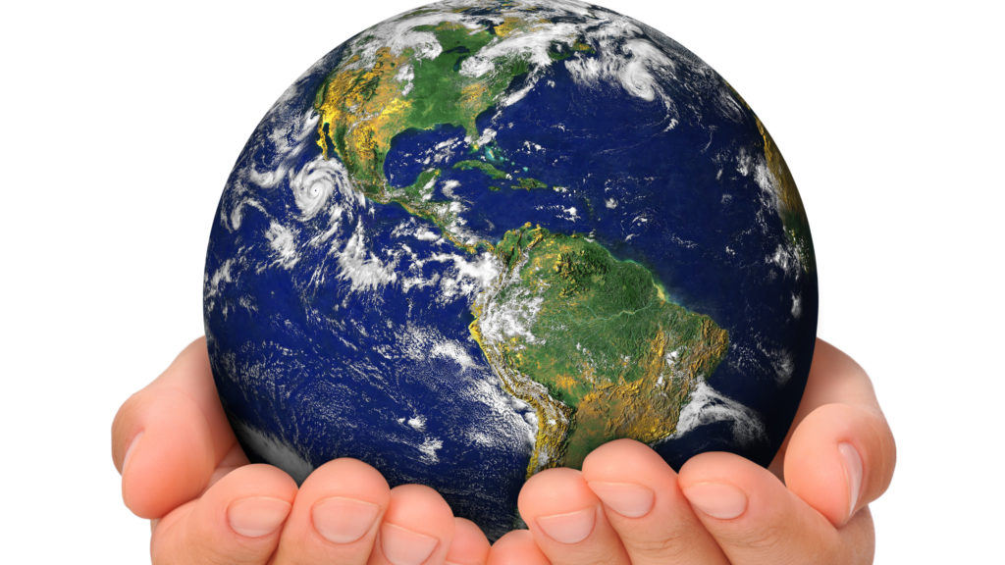
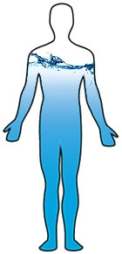
homeostasis

Slide 6
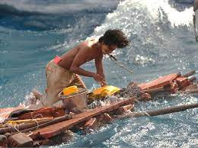
How long can we survive without water??

Slide 7
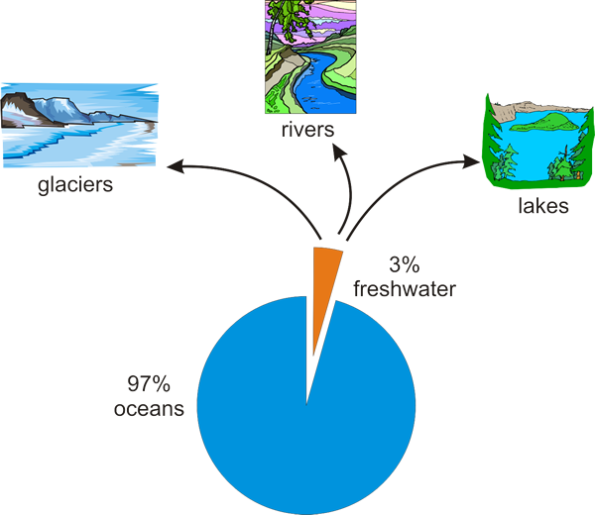
Where do we get FRESHWATER from?

Slide 8
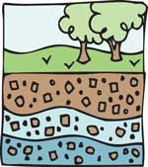
What is groundwater?

Slide 9
Would you drink this?

Slide 10
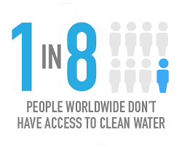
Access to clean water
Notes:
90% water remains untreated. Can you name some other ways water is polluted?

Slide 11
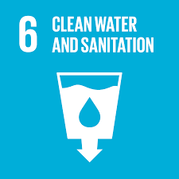
Lucky

Slide 12
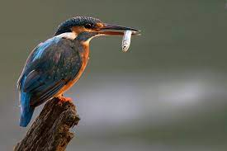
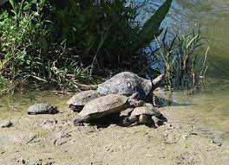
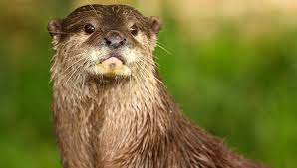
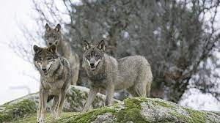
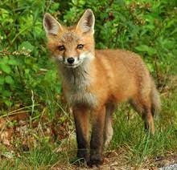
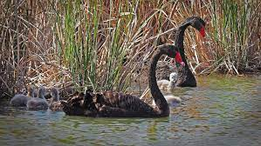
Humans are not the only species who depend on water

Slide 13
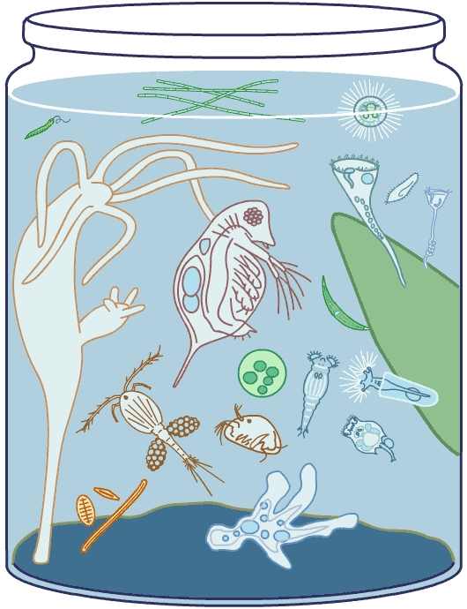
Scientist analysing water sample

Slide 14
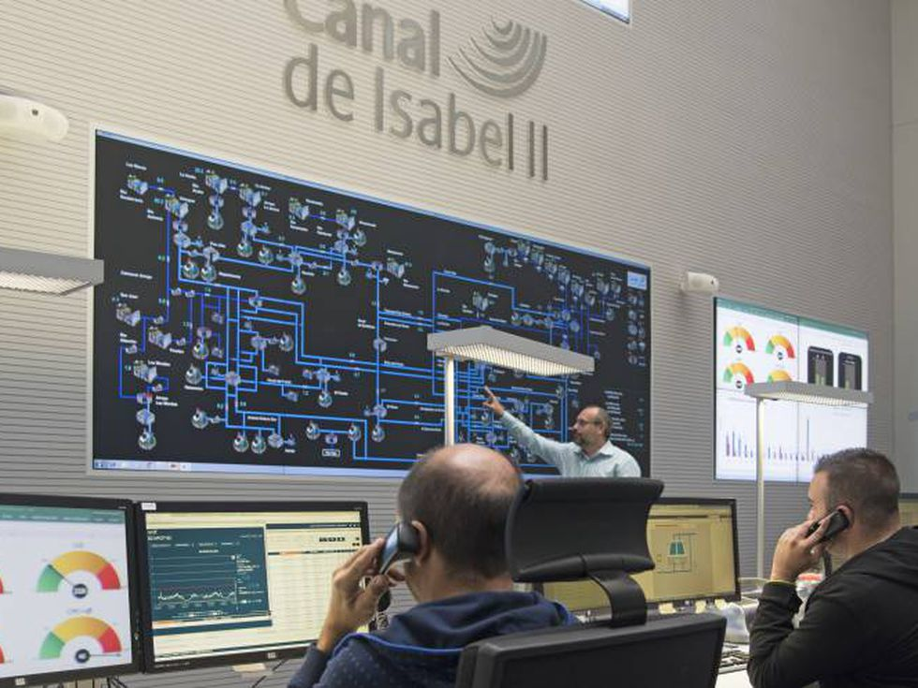
Canal de Isabel II manages the water supplies for the Comunidad de Madrid

Slide 15
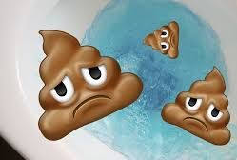
It cleans sewage and water so that they can be returned to the environment.
Valdebebas waste water treatment plant
Notes:
It removes solids and pollutants, break down organic matter and restore the oxygen content of treated water.

Slide 16
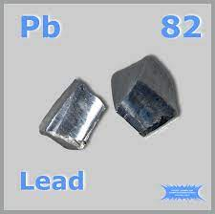
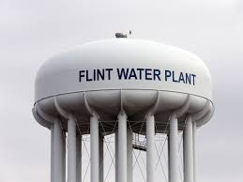
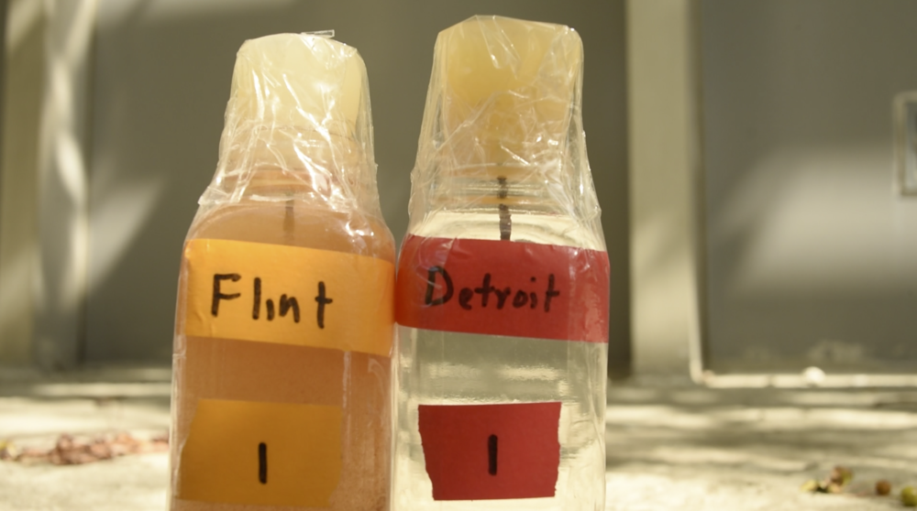
Notes:
The Flint water crisis was a public health crisis that started in 2014 and lasted until 2019, after the drinking water for the city of Flint, Michigan was contaminated with lead and possibly Legionella bacteria. ... Between 6,000 and 12,000 children were exposed to drinking water with high levels of lead.

Slide 17
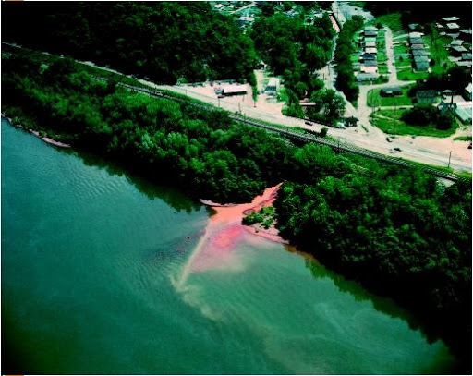
INDUSTRIAL POLLUTION: MAKING CLOTHES

Slide 18
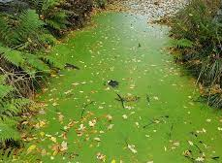
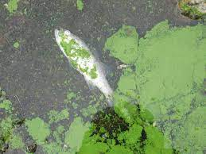
AGRICULTURAL POLLUTION: Fertilisers help plants and algae grow

Slide 19
DOMESTIC POLLUTION: Sewage leaks or is dumped straight into ground water
Notes:
90% water remains untreated. Can you name some other ways water is polluted?

Slide 20
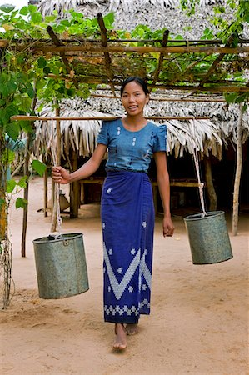
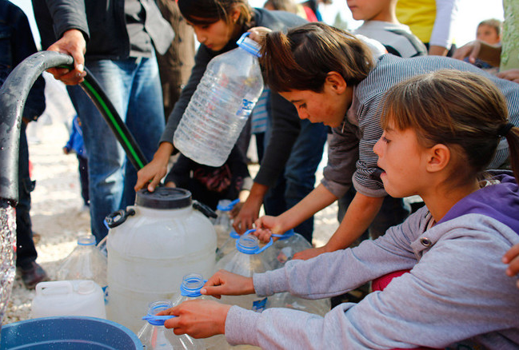
In many developing countries, millions of women and girls spend several hours a day collecting water from distant, often polluted sources.

Slide 21
A day in the life of Aysha
https://www.youtube.com/watch?v=teX2l_E40mw 1.59 mins
Notes:
8 hours

Slide 22
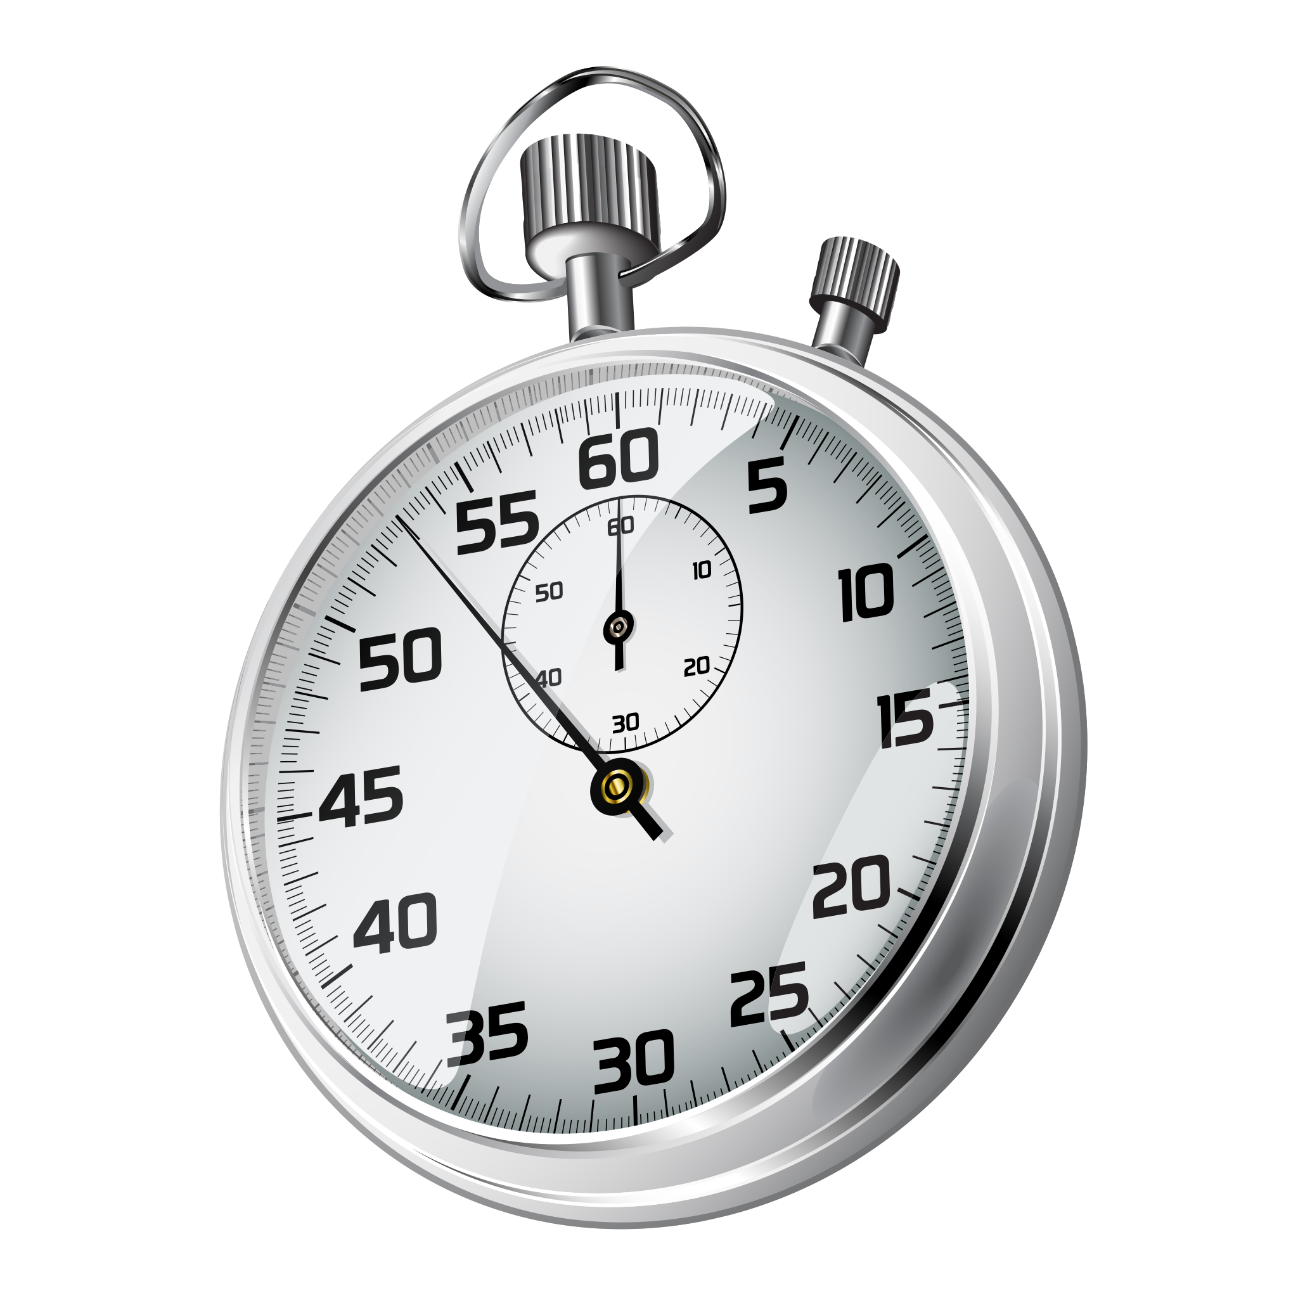
Diseases found in fresh water
Every minute a child dies of a water-related disease.
This Photo by Unknown Author is licensed under CC BY-NC

Slide 23
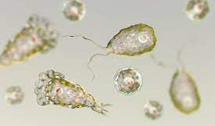
Brain-eating amoeba
Low risk
Notes:
138 cases

Slide 24
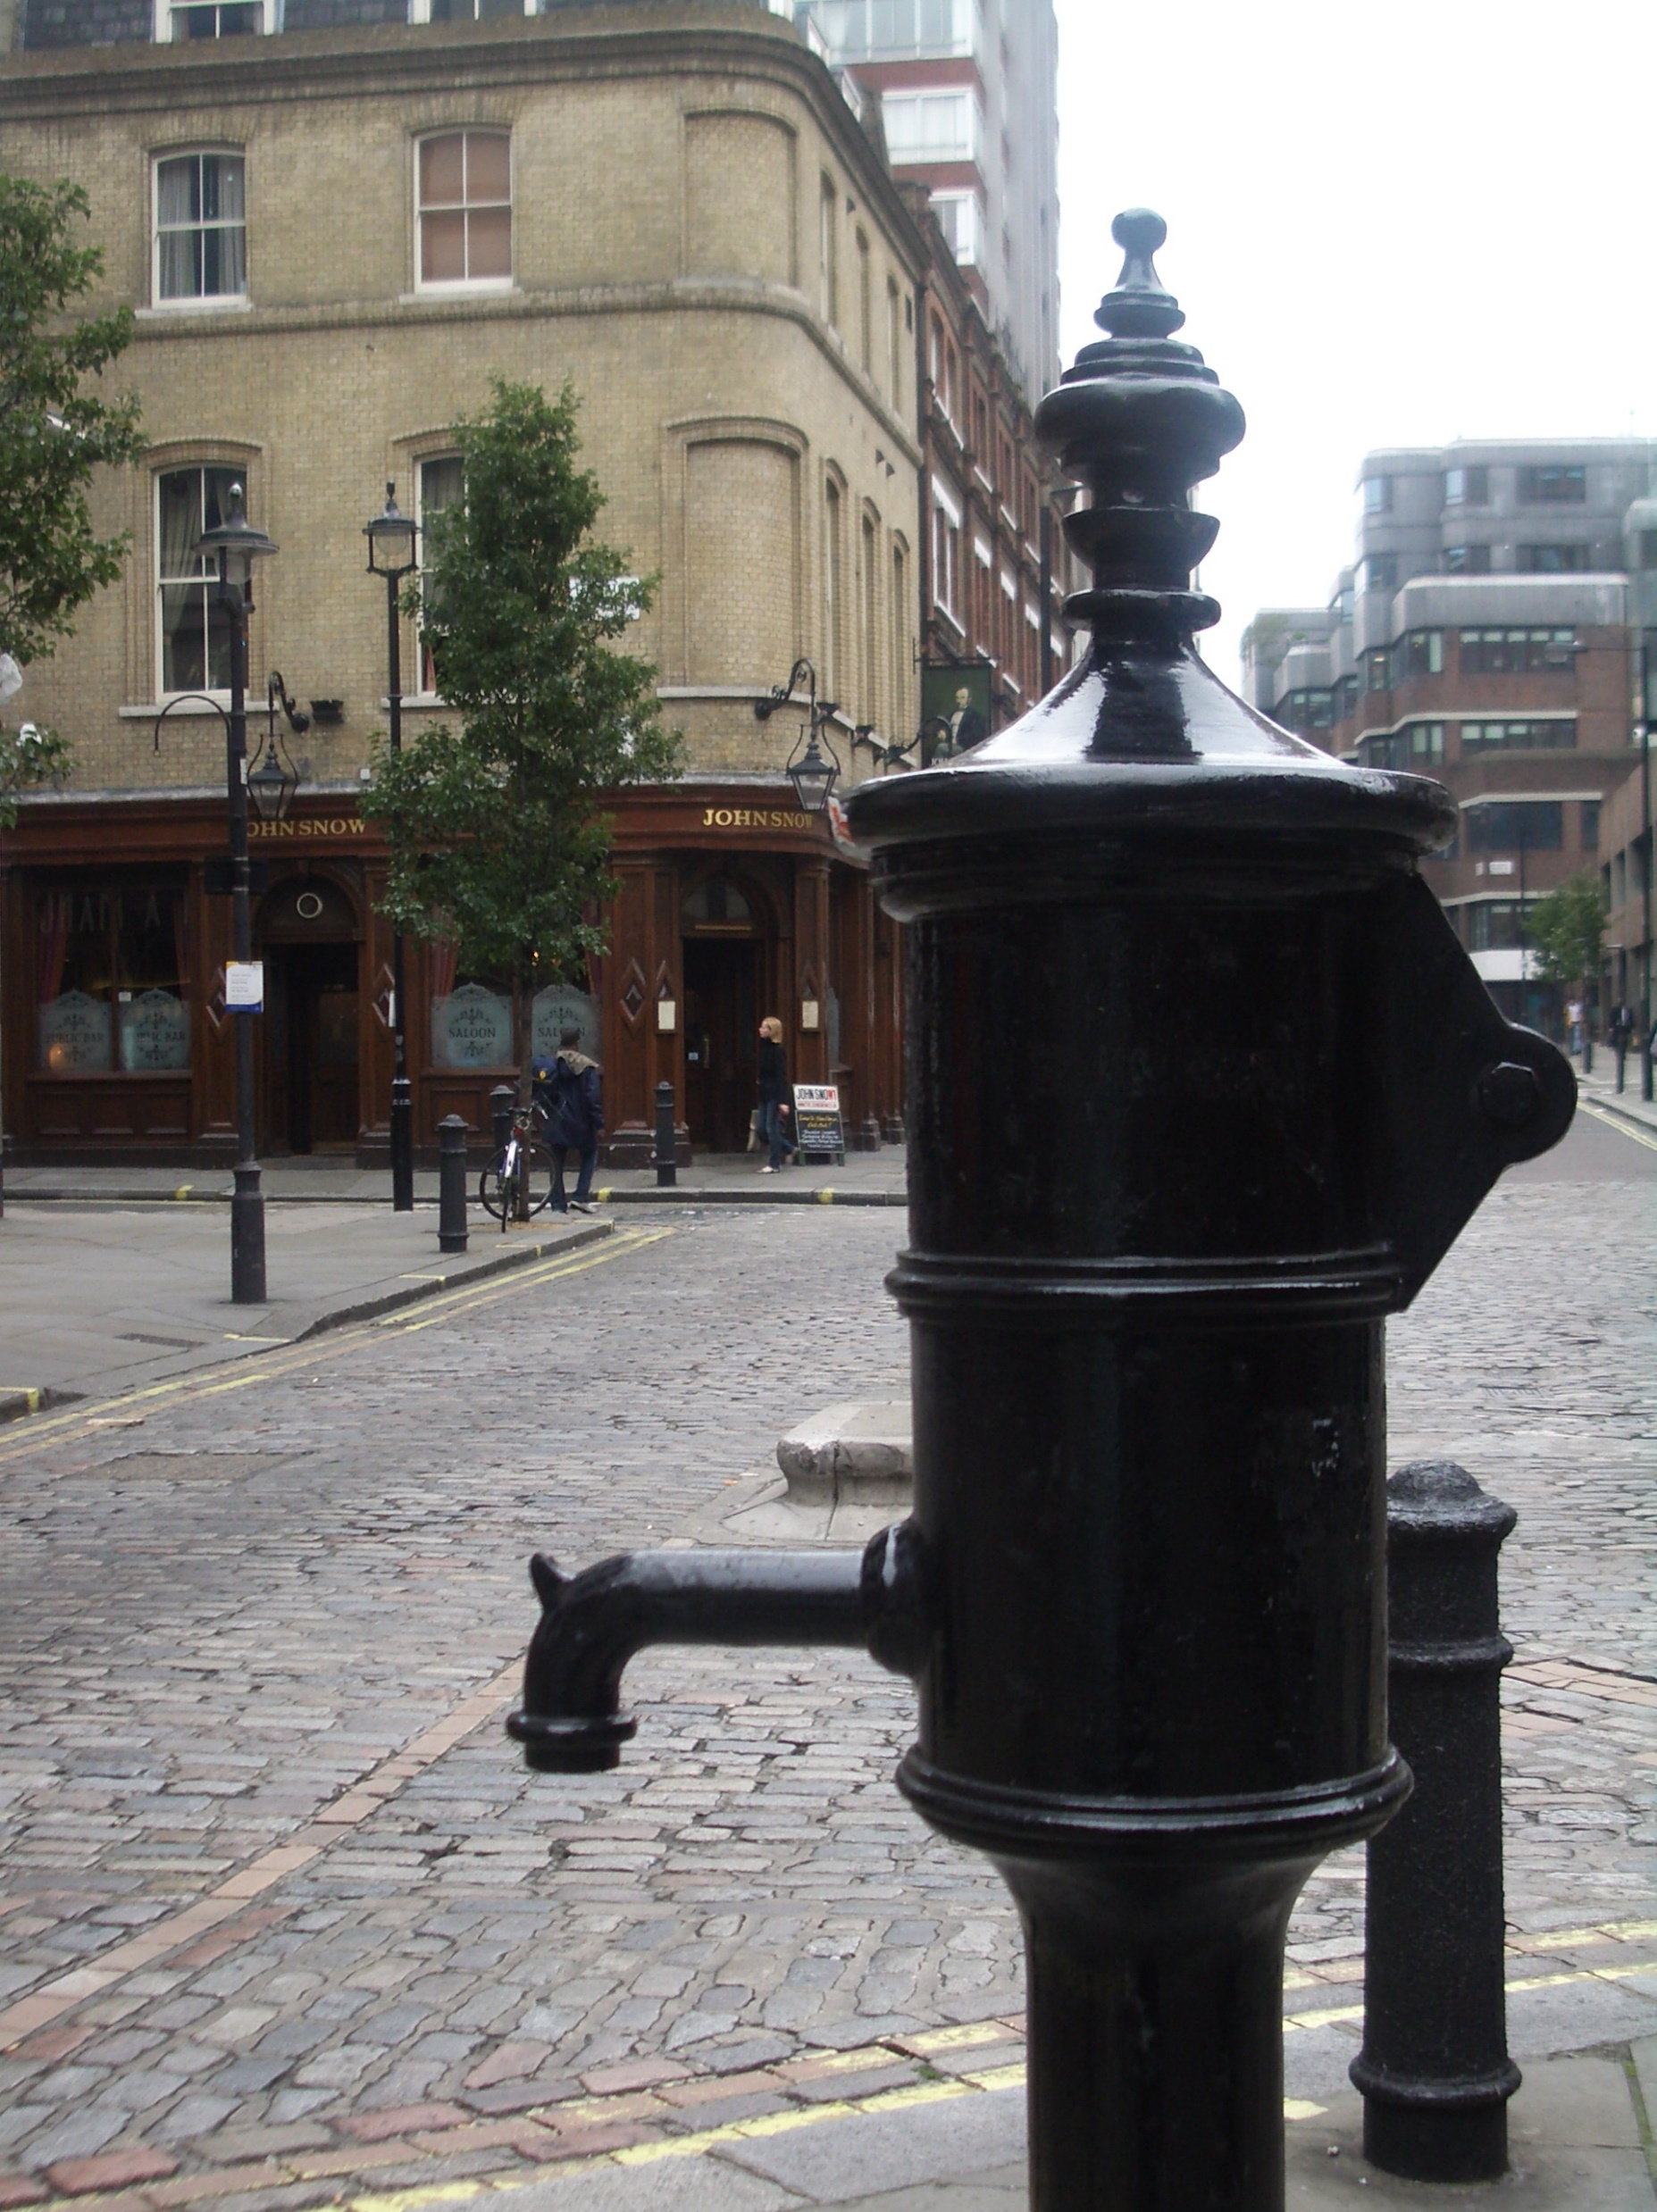
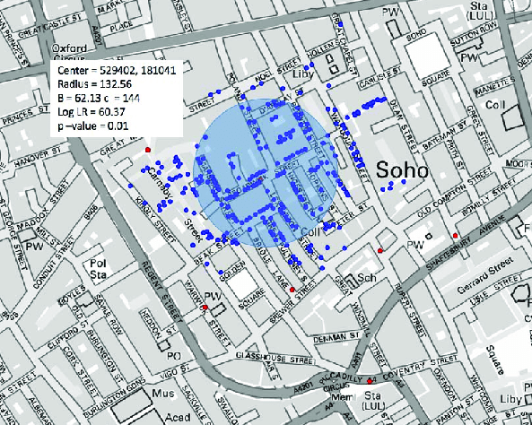
Cholera
Preventable
Cholera cases reported: In 2016, 132 121 cholera cases and 2420 deaths were reported to WHO worldwide.
54% of cases were reported from Africa, 13% from Asia and 32% from Hispaniola. Cholera remains a major public health problem and affect primarily developing world populations with no proper access to adequate water and sanitation resources.
Between 30,000–130,000 deaths a year

Slide 25
Life straw

Slide 26
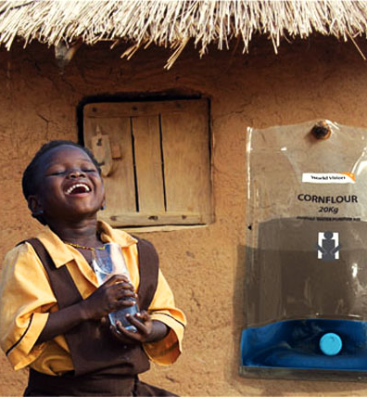
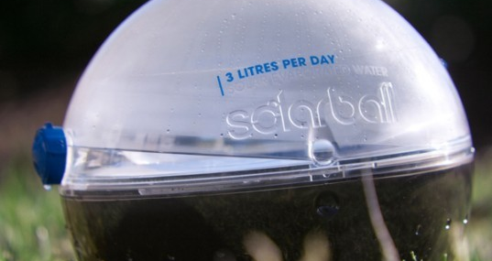
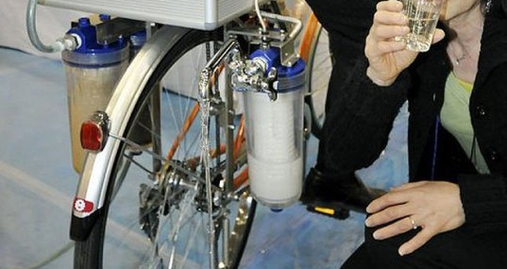
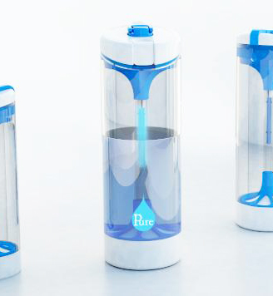
Solutions
Several inventions to provide solutions
Notes:
https://inhabitat.com/6-water-purifying-devices-for-clean-drinking-water-in-the-developing-world/

Slide 27
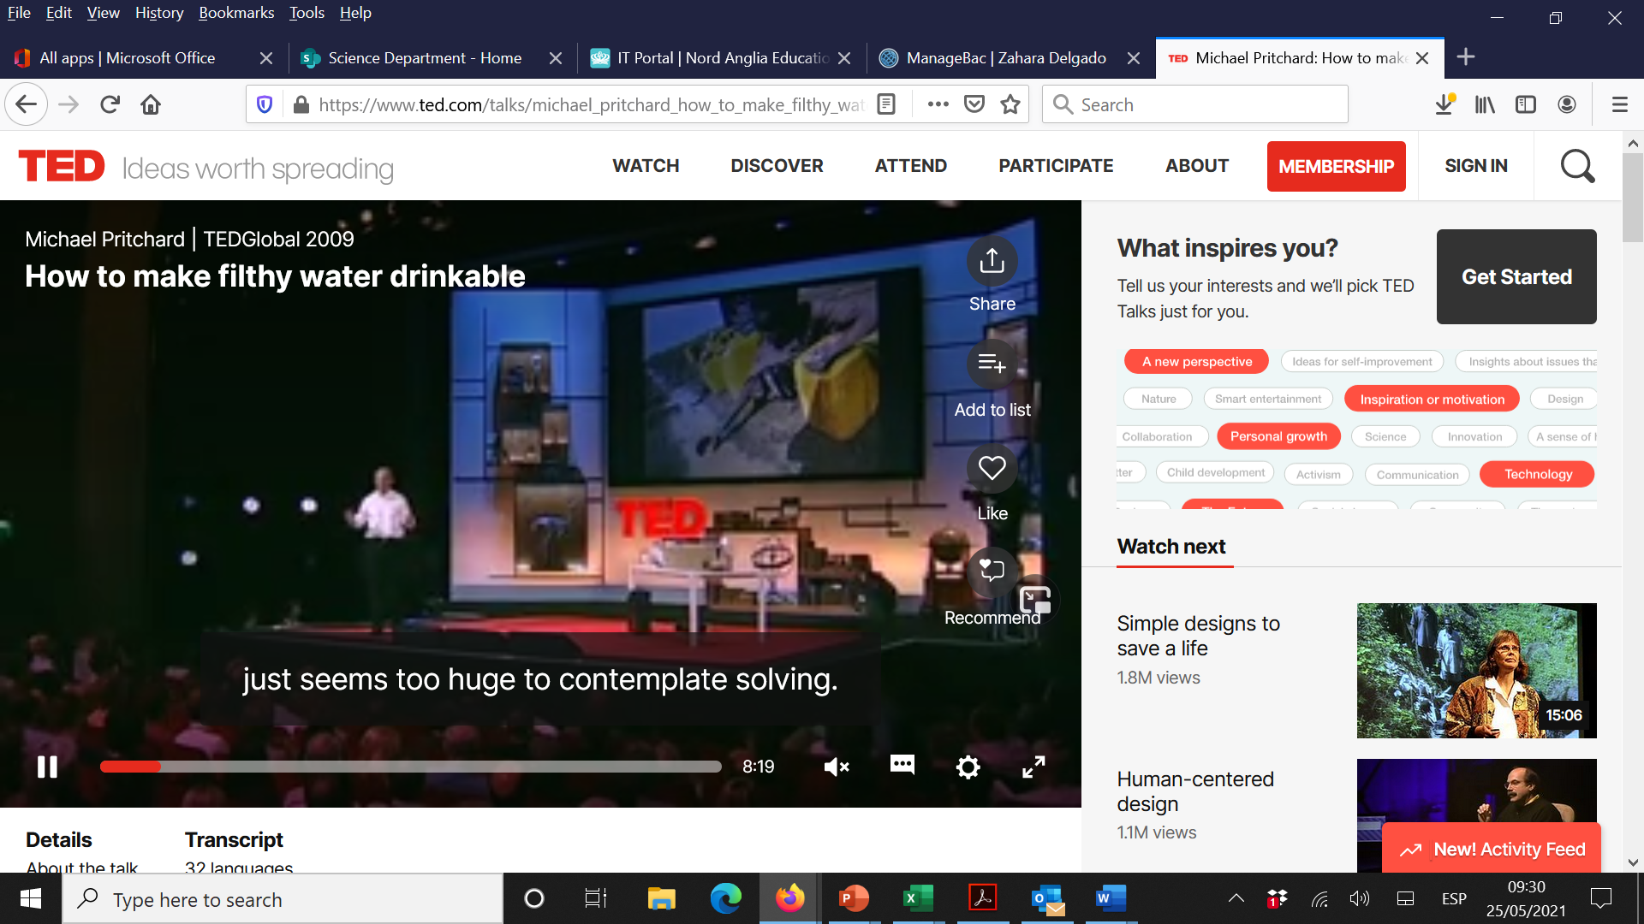

Slide 28
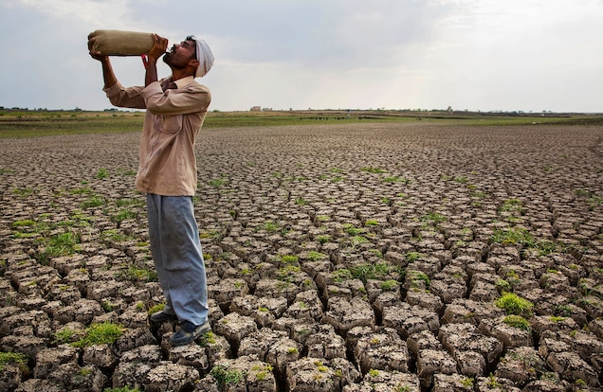
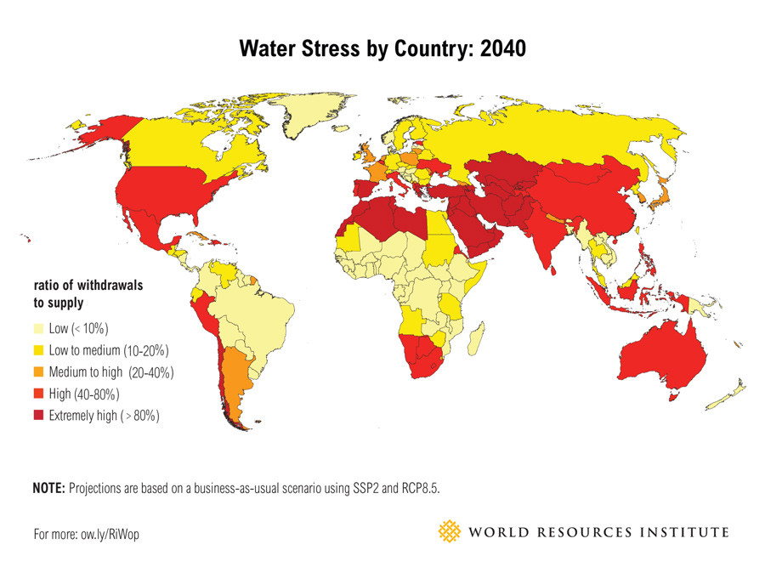
Future?

Slide 29
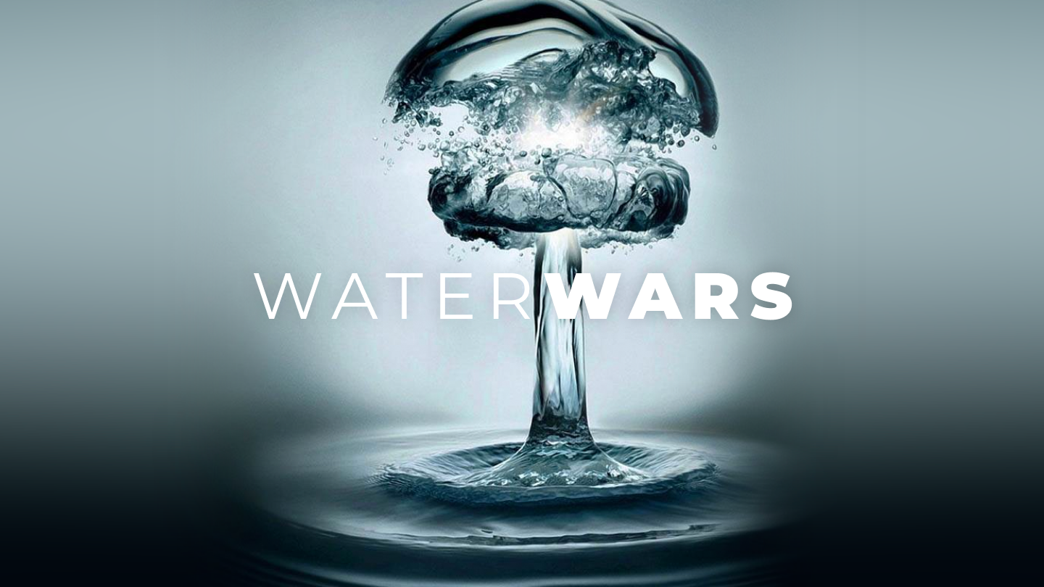

Slide 30
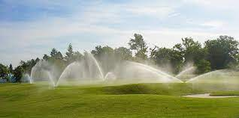
Proposal: The city council should pass a law requiring all businesses and people to reduce their water use.

Slide 31
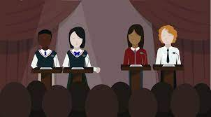
Debate roles
Owner of a golf company:
Pablo, Ignacio, Isabella, Judy
2. A parent of 5 children:
Fran, Ruben, Cal, Andrea
3. Canal Isabel segunda:
Ana, Shahad, Jorge, Mathilde
4. An environmentalist:
Carolina, Andre, Victoria, Luis
5. A city council worker
Alberto, Kiersten, Blanca, Alex

Slide 32
DEBATE SKILLS

Slide 33
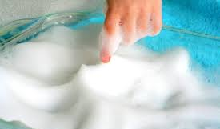
How does the type of water used affect the volume of soap needed to form lather?
Use the title to identify the independent and dependent variable.

Slide 34
Types of water

Slide 35
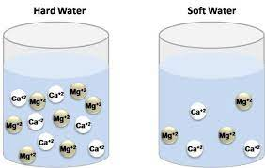
Hard water

Slide 36
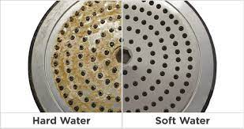
Conclusion

Slide 37
Importance

Slide 38
REVISION
Unit 1
Unit 2
Unit 3
Unit 4

