Slide 1
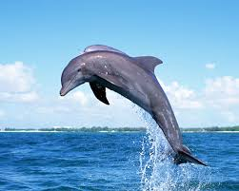
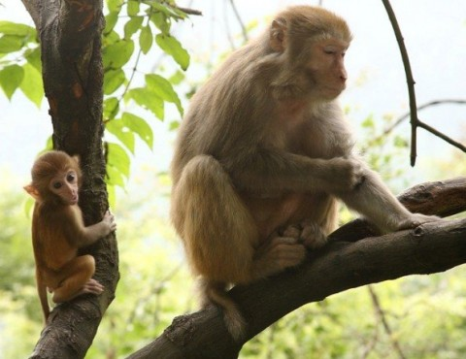
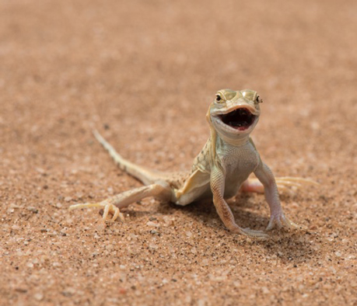
Title: Natural selection
Starter: Each of these animals lives in very different environments, and display very different features. In your books answer the questions below:
State the name of each animal above
Describe the environment of each animal above
Explain the features of each animal – e.g. fins for swimming
Link the features of each animal to their success within their particular environment – e.g. Would a dolphin be successful in the trees? Why not?

Slide 2
Title: Natural Selection
LO: To describe evolution and explain the role of natural selection within the process
State the meaning of evolution
Discuss the process of evolution
Describe the process of natural selection
Analyse how organisms may evolve over time

Slide 3
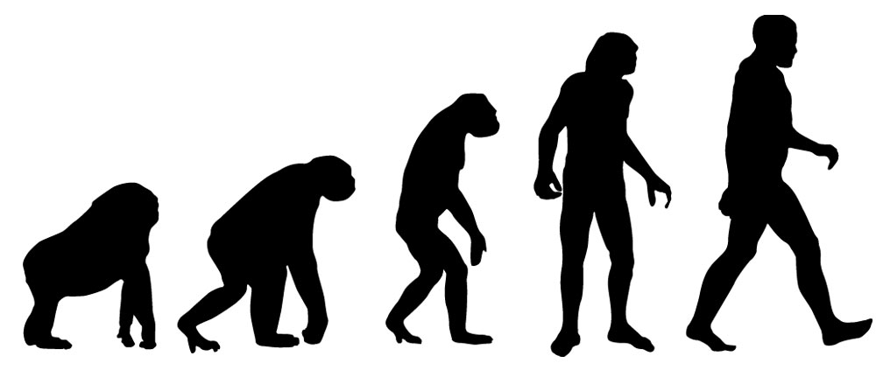
What is evolution?
1 minute
End
Time

Slide 4
What is evolution?
Science has shown that species which exist today have developed over millions of years
This process is referred to as evolution.

Slide 5
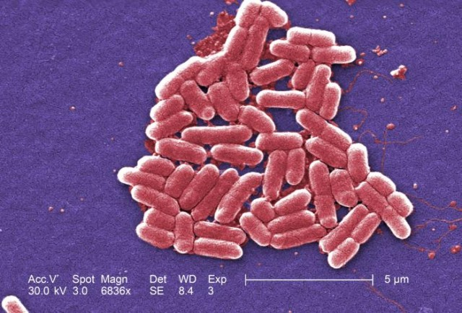
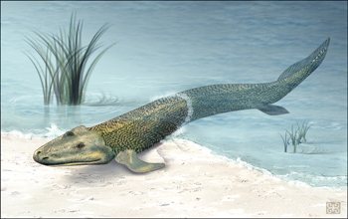
The start of evolution
Evolution started with unicellular organisms.
These organisms, similar to bacteria, lived in water more than 300 billion years ago
Overtime they evolved to become multicellular organisms
Eventually this process resulted in organisms that could also live on land and in the air

Slide 6
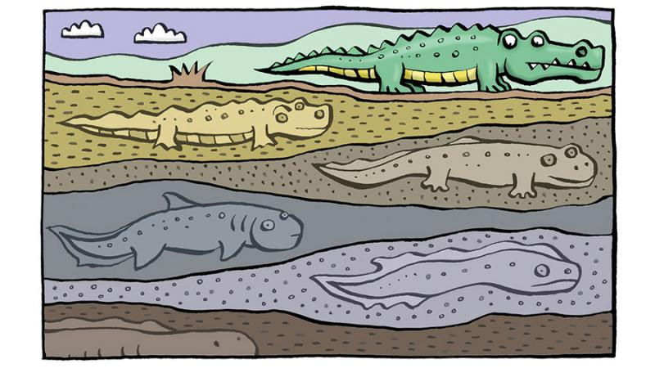
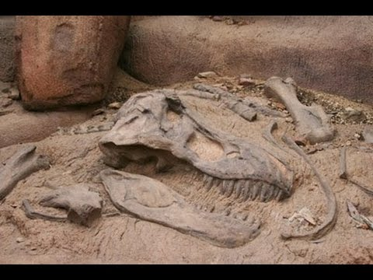
Fossils as evidence of evolution
The fossil record provides most of the evidence for evolution
Fossils are the remains of plants and animals that lived many years ago
They are preserved by natural process, and provide evidence of animals that no longer exist – such as dinosaurs

Slide 7
Learning checkpoint – fill in the blanks
The species on earth today have _________ over _________ of years. This process is known as _________. The process started with ____________ organisms which lived in _________, over time these evolved to become _____________. This eventually produced the animals of the ______ and ______ we observe today. Most of the evidence for evolution comes from _________.
evolved
millions
evolution
unicellular
water
multicellular
land
air
fossils
unicellular, land, evolution, fossils, water, air, multicellular, evolved, millions
Stretch: Which animal do you think humans could of evolved from? Why? What could cause organisms to evolve?
End

Slide 8
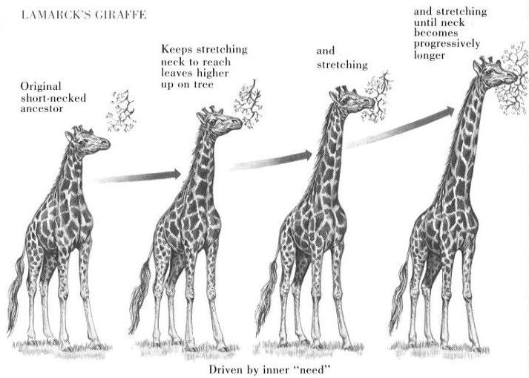
How do organisms evolve?
Organisms evolve through a process of natural selection.
They change slowly over time to become better adapted to their environments
This process takes many years, as it happens over a number of generations.
An example is seen in the giraffe neck size
What advantage would a longer neck give the giraffe?

Slide 9
Iguanas – a living example
Can you think what the driving force of the iguanas evolution was?
In what way did the iguanas features change?
What advantages did it give the iguanas?

Slide 10
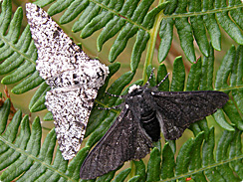
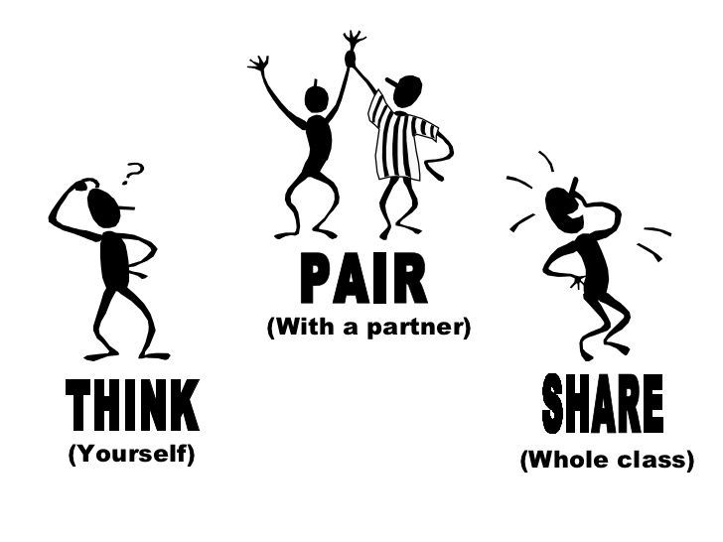
Another example - Peppered moths
Dramatic changes to an organisms environment can make evolution occur quickly:
Before the industrial revolution most peppered moths in Britain were pale in colour, helping them to blend into the tree bark
A few peppered moths were dark in colour, these were easily seen and eaten by birds
After the industrial revolution many trees became covered in soot and became dark
How do you think this may have changed the population of peppered moths?
End

Slide 11
Natural selection – Sticky dogs
End

Slide 12
Plenary – what have we learnt today?
State the meaning of evolution
Discuss the process of evolution
Describe the process of natural selection
Analyse how organisms may evolve over time
Task: In your books write a sentence or two discussing which learning objectives you have reached today.
Are there any bits you found easy or interesting?
Are there any parts you found difficult?
How could you improve on your current knowledge.

