Slide 1
Material Science

Slide 2

Animal homes → Human homes?
Using Photogrid (or a word file) to make a collage of at least 6 homes from different parts of the world.
  Photogrid – collage of 6 to 9 photos. Download final file as jpg. Import to word – add a label of the location for each home.
Stick with single family homes OR apartment buildings with homes for many families (try to avoid doing both).
Try to find homes that are very diverse in terms of their structure a and materials used for construction.
Suggest at least 3 reasons why houses are constructed differently in different geographic locations.

Slide 3
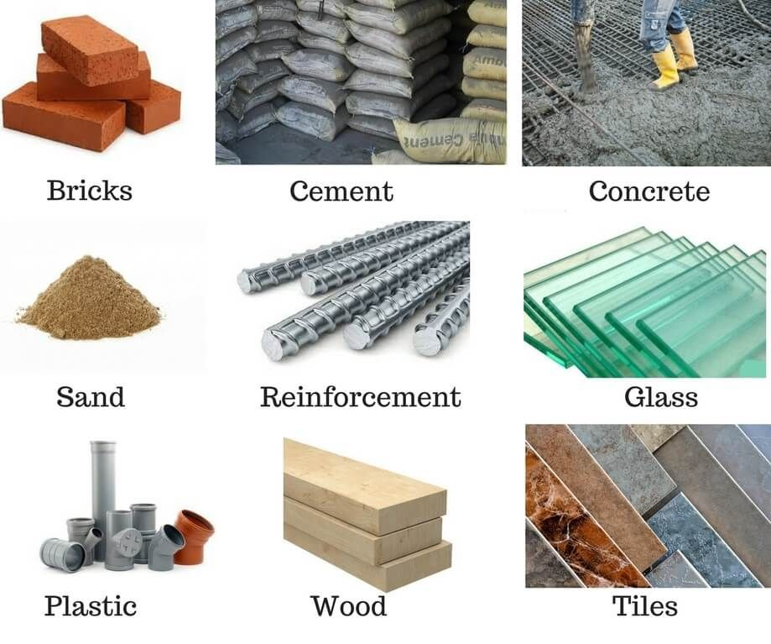
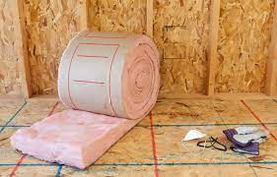
Name the building materials

Slide 4
ANSWERS
Insulation

Slide 5
Build this in…
Concrete:
  Discuss the properties of concrete, such as its compressive strength, durability, and workability.
  Explore its wide range of applications in construction, including foundations, columns, beams, and slabs.
  Highlight the importance of proper curing and reinforcement to enhance the strength and longevity of concrete structures.
Steel:
  Explain the properties of steel, such as its high strength, ductility, and durability.
  Discuss its applications in structural elements like beams, columns, and trusses due to its ability to resist heavy loads and provide flexible design options.
  Explore its use in reinforcement within concrete structures to enhance overall strength and structural integrity.
Wood:
  Introduce the properties of wood, including its strength, stiffness, and natural insulating properties.
  Discuss the various types of wood used in construction, such as softwood and hardwood, and their applications in framing, flooring, and finishing.
  Highlight the sustainability aspects of wood as a renewable and carbon-neutral building material.
Masonry:
  Explore the properties of masonry materials like brick, stone, and concrete blocks, including their compressive strength, durability, and fire resistance.
  Discuss their applications in load-bearing walls, facades, and decorative elements in both residential and commercial construction.
  Explain the importance of proper mortar selection and techniques for strong and stable masonry structures.

Slide 6
Properties of building materials
https://www.youtube.com/watch?v=340MmuY_osY
3.57 mins

Slide 7



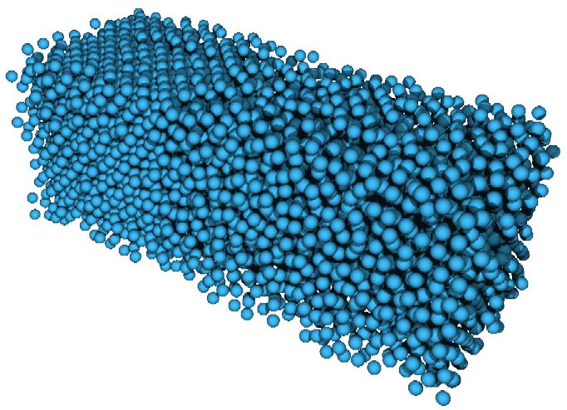
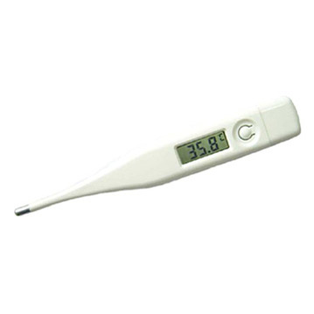
Properties of metals
Malleable
Electrical conductor
Ductile
Thermal conductive
Shiny
Solid at RT
High melting point

Slide 8
STATE THE OPPOSITES
Elastic
Strong
Brittle
Insulating
Dense
Absorbent
Hard
Transparent

Slide 9
STATE THE OPPOSITES
Elastic /Inelastic
Strong /weak
Brittle /flexible
Insulating /conducting
Dense /?
Absorbent /Non-absorbant
Hard /soft
Transparent /Opaque

Slide 10
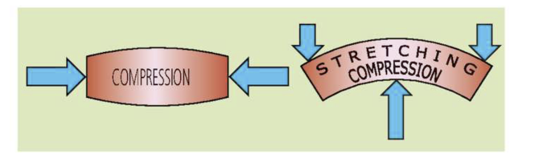
Withstanding Tension and Compression
Under tension (pulling forces) some materials tend to crack. Those that are brittle and inelastic (ie. Stone, glass, concrete)
Under compression (pushing forces) some materials get crushed, tear, or shatter. Those that are weak (ie. Wood, glass, plastic)

Slide 11
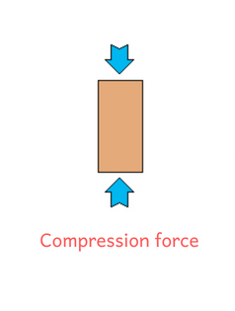
1. Draw the diagram below
2. Deduce and draw a similar diagram to show
tension force

Slide 12

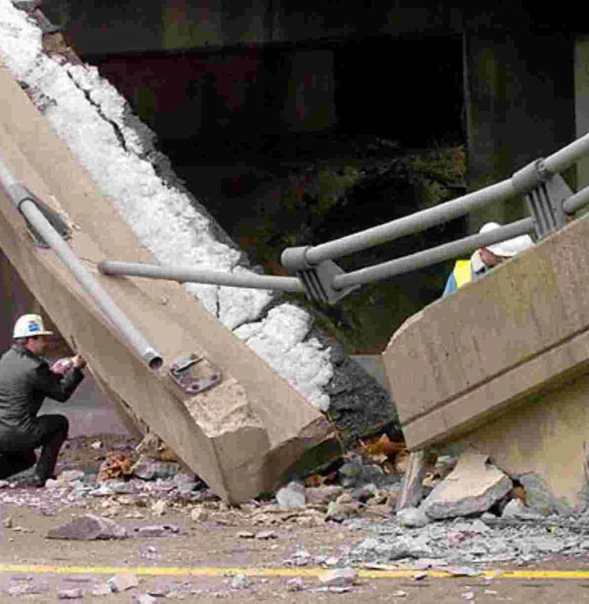
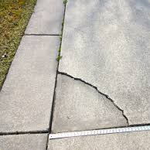

How can we make concrete stronger?
By the end of the lesson you will be able to:
Apply a method to determine the strength of material

Slide 13
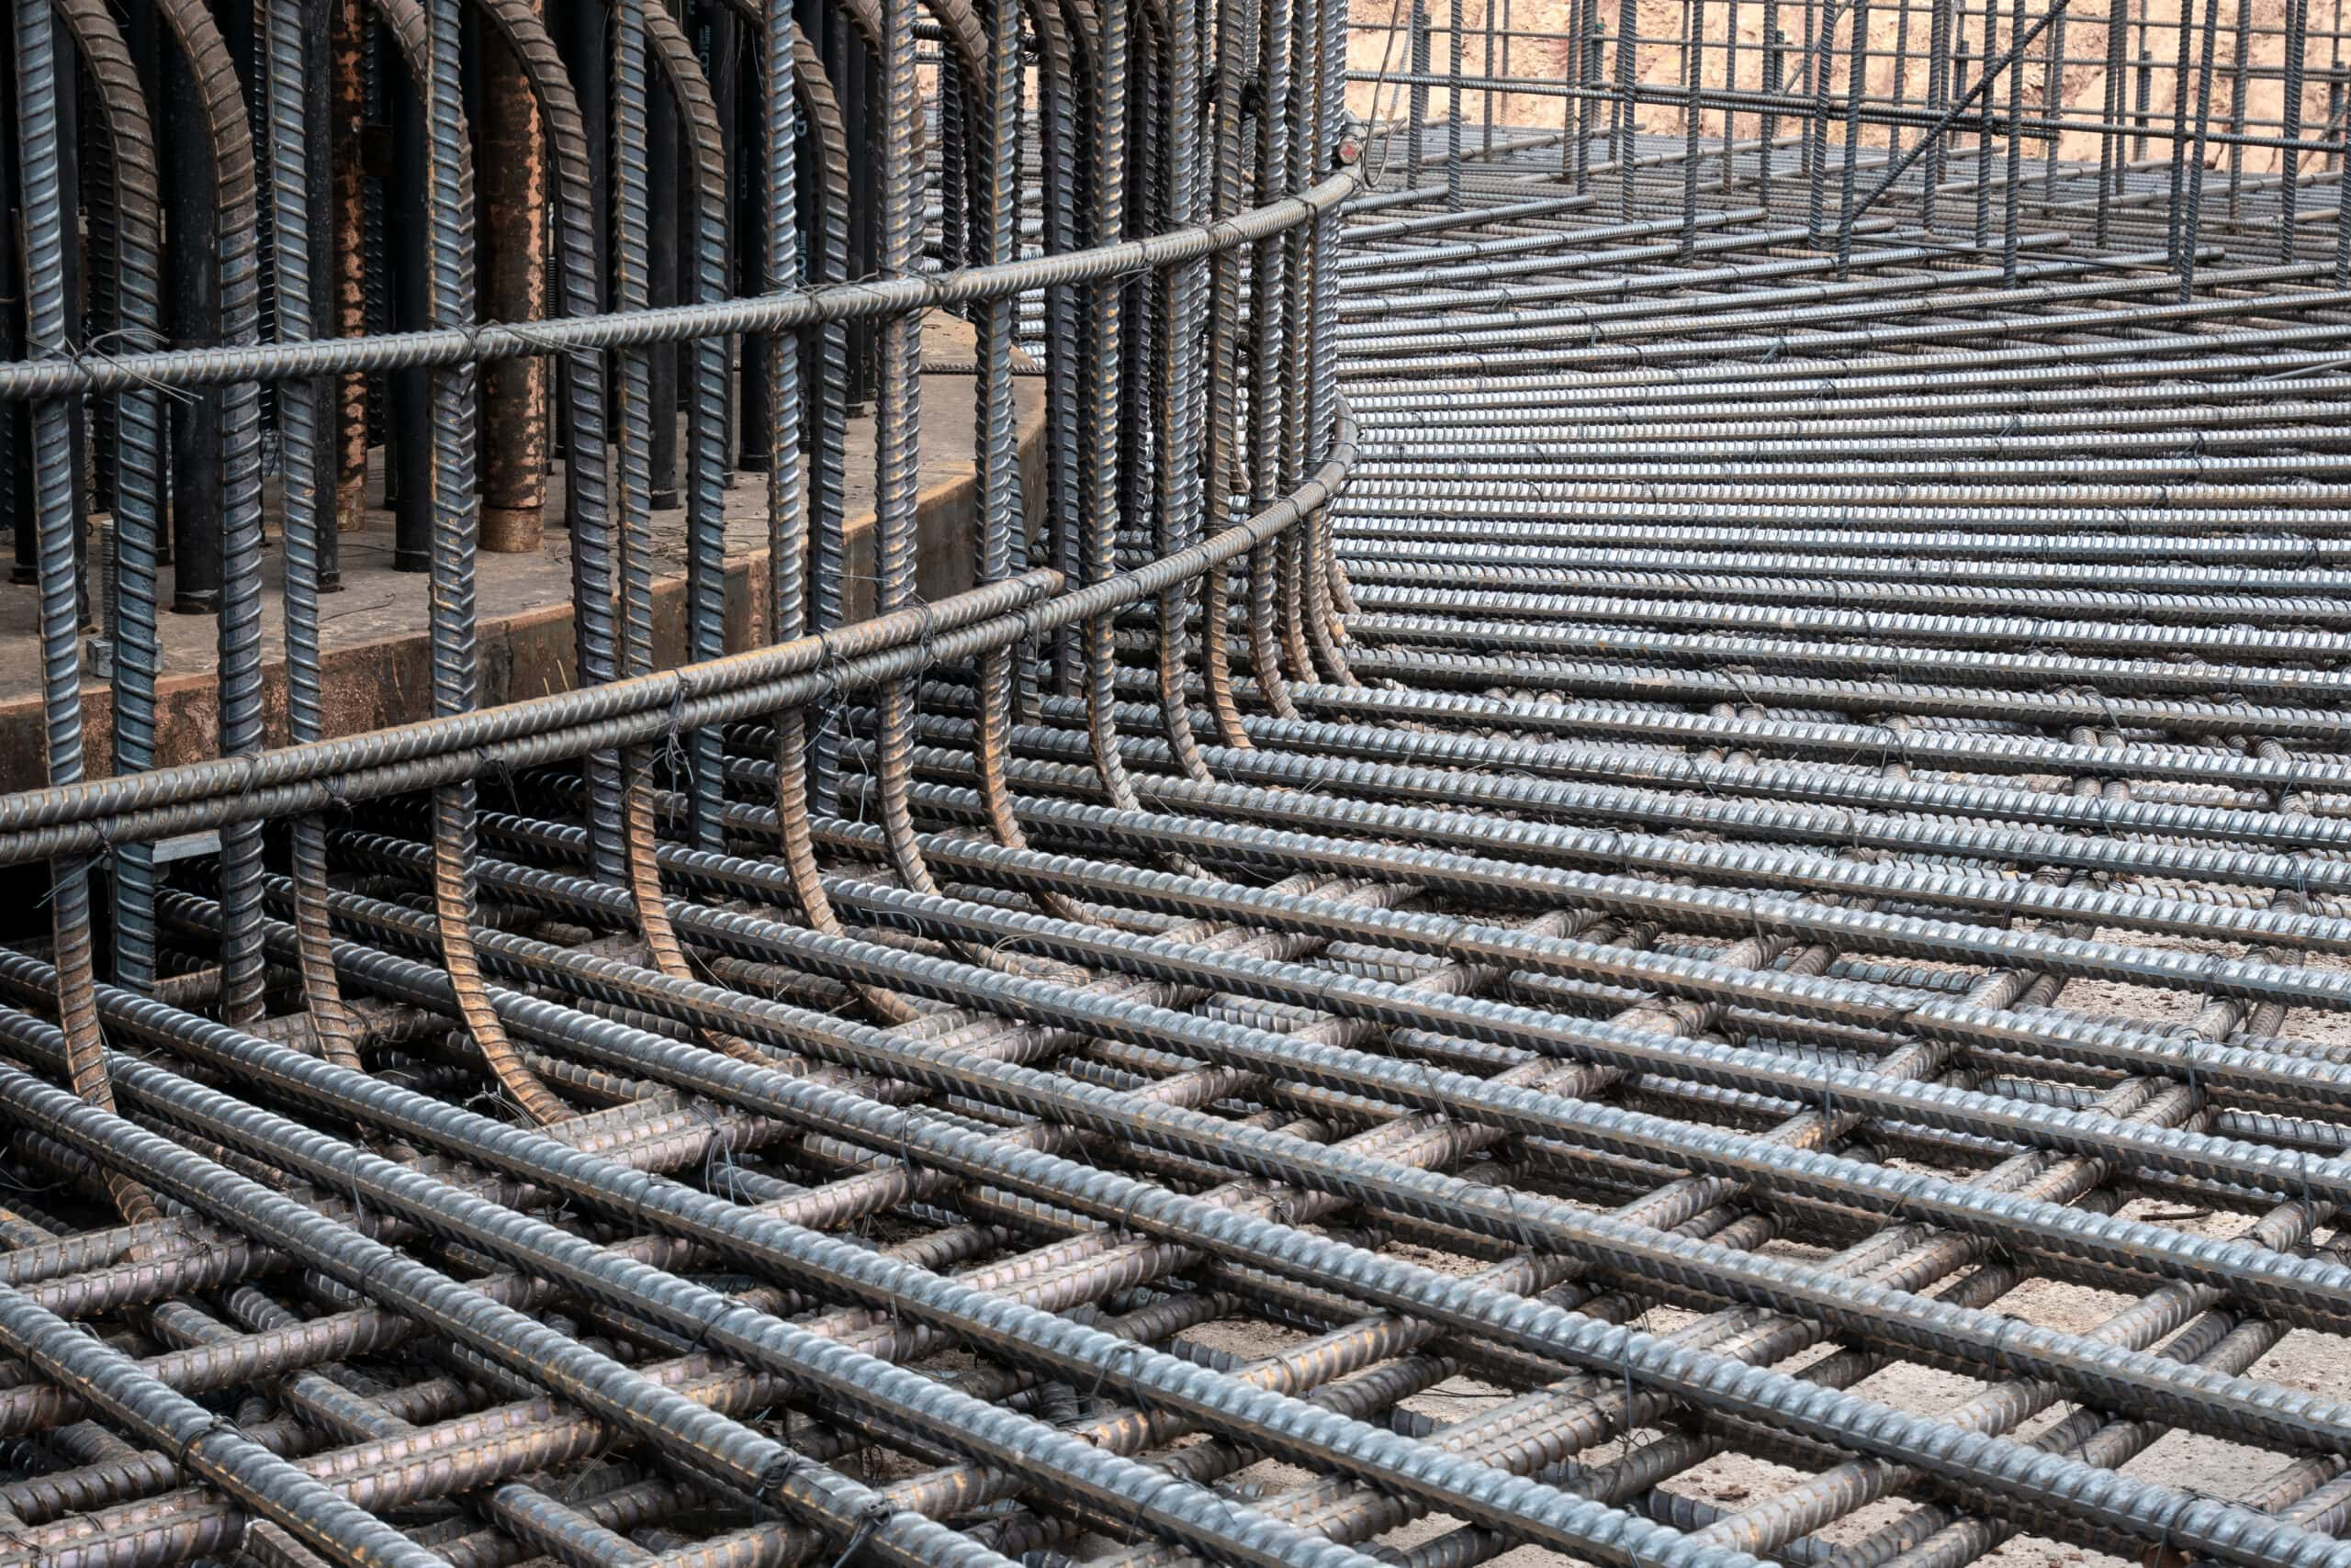
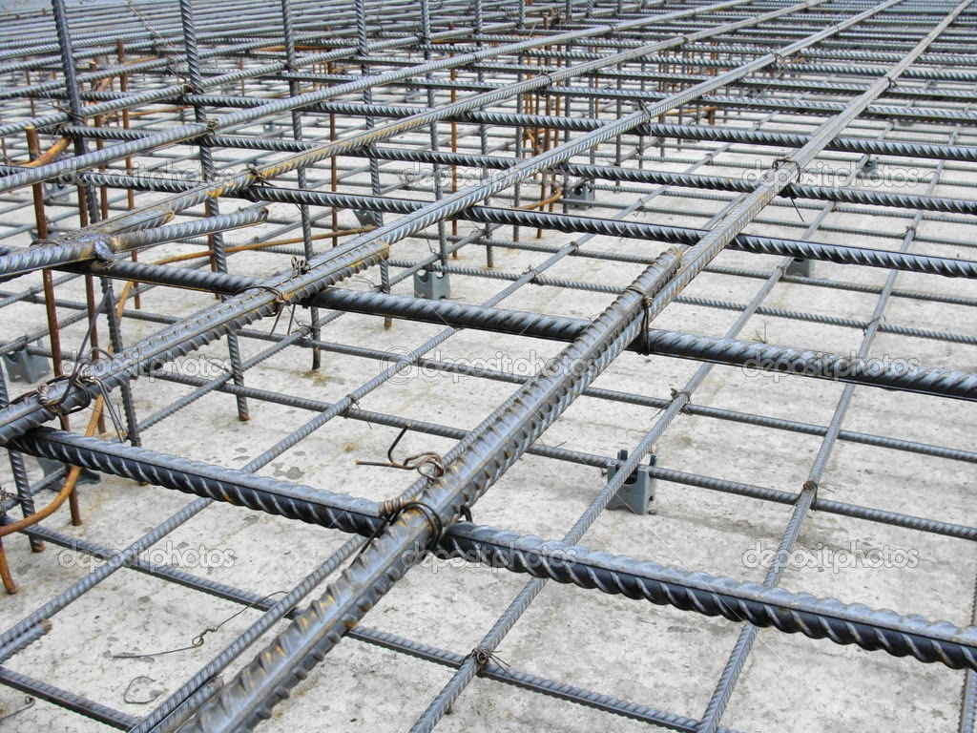
Reinforced concrete
Combines:
  concrete - a strong material that withstands compression with
  steel – a strong material that resists tension.

Slide 14
Keywords
Concrete: a building material made from a mixture of broken stone or gravel, sand, cement, and water, which can be spread or poured into moulds and forms a mass resembling stone on hardening.
Cement: a powdery substance made by calcining lime and clay, mixed with water to form mortar or mixed with sand, gravel, and water to make concrete.

Slide 15
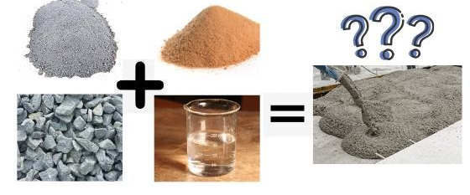
Identify the materials

Slide 16
Concrete experiment exploration
Mixture 1: Using a mass balance and a weighing boat to carefully weigh each ingredient, you need to combine:
  4 grams cement
  12 grams sand
  8 grams gravel
  2 grams water (must be last)
Mix thoroughly with stirring rod (after each new addition)
Transfer to one space in the ice cube tray.
Change the amount of sand or gravel to create a second mixture ratio (you decide) and make sure to write it down – Mixture 2.
After 24 hours setting time, remove the concrete bars, span them two chairs or tables, attach a loop of string, and add masses until they break. Note the mass they were able to sustain.
Design an experiment (Criterion B) in which you choose either sand or gravel ratio in your concrete mix as your independent variable.
When you vary the amount of sane and gravel it must add up to a total mass of 20g

Slide 17
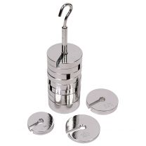

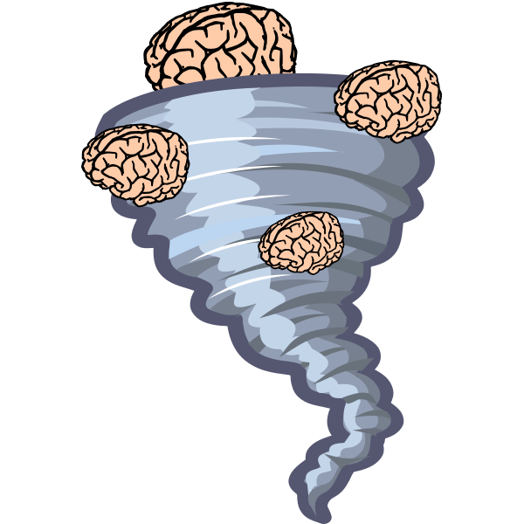
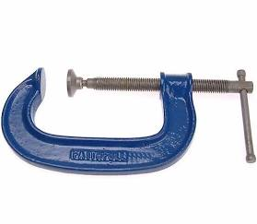



These are your methods for testing the strength of cement.
Evaluate which is best.
Masses can then be added to the
centre of the bar until it breaks.
Drop a boulder on it
Dropping from an increasing height until it breaks
A 'g' clamp can be applied to the centre of the sample and screwed until cracks appear in the concrete.
Strong wind
Hitting it with a hammer

Slide 18
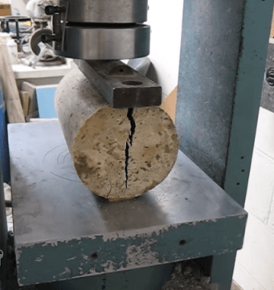
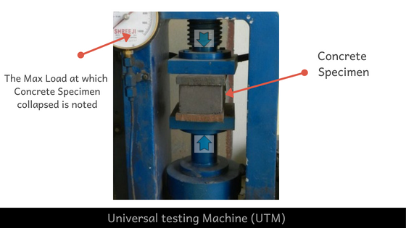
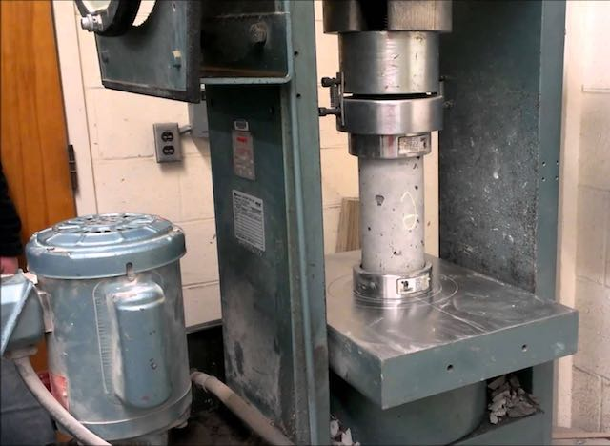
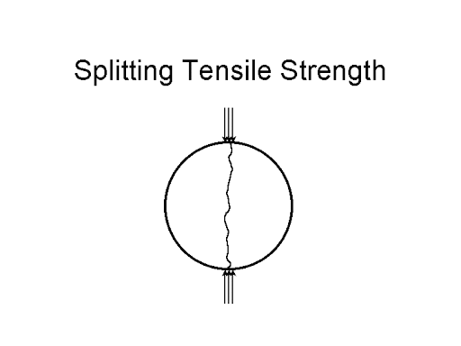
Compare your method

Slide 19

Control variables:
Control variable. Choose the most significant ones , the ones that will have most impact on results if not controlled. (include units) | How will it be measured? Include equipment used | Why Will it be measured? Include what Will have to the Dependent variable if this control variable is high and lower.

Slide 20
Properties of materials
https://www.youtube.com/watch?v=340MmuY_osY
3.57 mins

Slide 21
Match the opposites
Keyword | Definition
Brittle
Conductivity
Corrosion Resistance
Density
Ductility / Malleability
Elasticity
Toughness
Hardness
Plasticity

Slide 22
If you are interested in material science
Watch this https://www.youtube.com/watch?v=4-_rwDgLMpk 28 mins

Slide 23
If you are interested in material science – Smart materials
Watch this https://www.youtube.com/watch?v=4-_rwDgLMpk 28 mins

Slide 24
Smart materials
Shape Memory Alloys (SMAs): These materials have the ability to "remember" their original shape and return to it when subjected to heat or other stimuli. One well-known shape memory alloy is Nitinol, a combination of nickel and titanium.
Piezoelectric Materials: These materials generate an electric charge in response to mechanical stress and can also undergo mechanical deformation when subjected to an electric field. They find applications in sensors, actuators, and energy harvesting devices.
Electrochromic Materials: These materials change color or opacity in response to an electrical stimulus. They are used in smart windows, rearview mirrors, and displays.
Thermochromic Materials: These materials change color with temperature variations. They are often used in temperature-sensitive coatings, thermometers, and color-changing textiles.
Photochromic Materials: These materials change color in response to light, especially UV radiation. They are used in sunglasses, photochromic lenses, and novelty items like color-changing toys.
Magnetorheological (MR) Fluids: These are fluids that change viscosity in response to the application of a magnetic field. They find applications in shock absorbers, clutches, and adaptive damping systems.
Conductive Polymers: These are polymers that exhibit electrical conductivity. They can be used in flexible electronics, sensors, and actuators.
Self-Healing Materials: These materials have the ability to repair damage or regain their structural integrity after being damaged. They find applications in coatings, adhesives, and structural components.
Hydrogels: These are soft, water-swollen materials that can change shape or size in response to external stimuli such as temperature, pH, or electric fields. They are used in biomedical applications, including drug delivery systems and tissue engineering.
Shape-Shifting Polymers: These materials can change their shape in response to external stimuli like heat, light, or moisture. They find applications in robotics, biomedical devices, and soft actuators.

Slide 25

Smart Materials
Video is 5 years old. Think how much further scientists have come.
https://www.youtube.com/watch?v=4-_rwDgLMpk 8.35 mins
This Photo by Unknown Author is licensed under CC BY-SA

