Slide 1
Sunday, 19 May 2024
Electrical circuits
By the end of the lesson you will be able to
Draw the circuits you build using correct symbols
Describe what current is

Slide 2
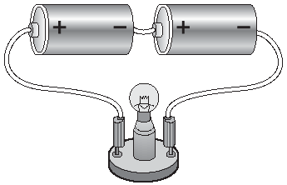
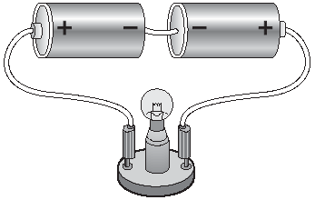
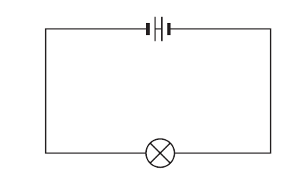
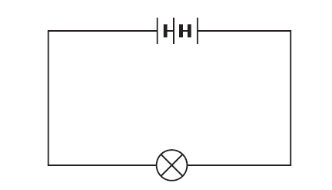
Which ones won’t work?

Slide 3
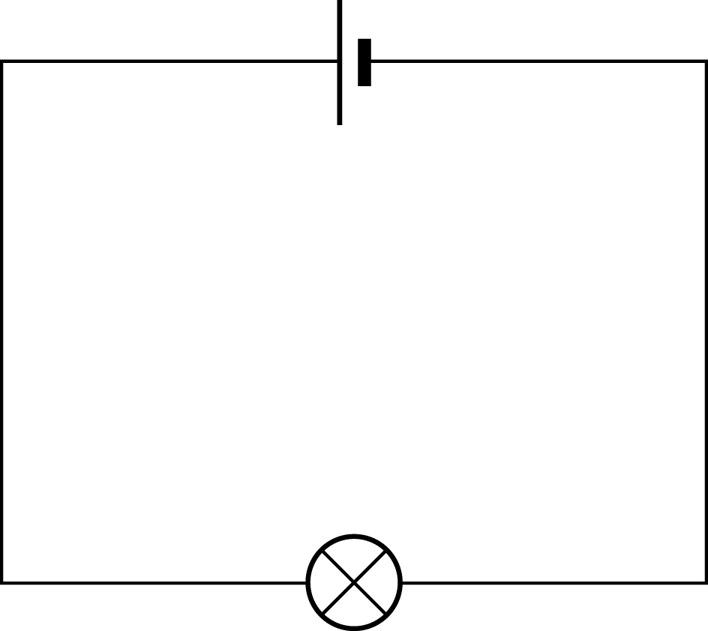
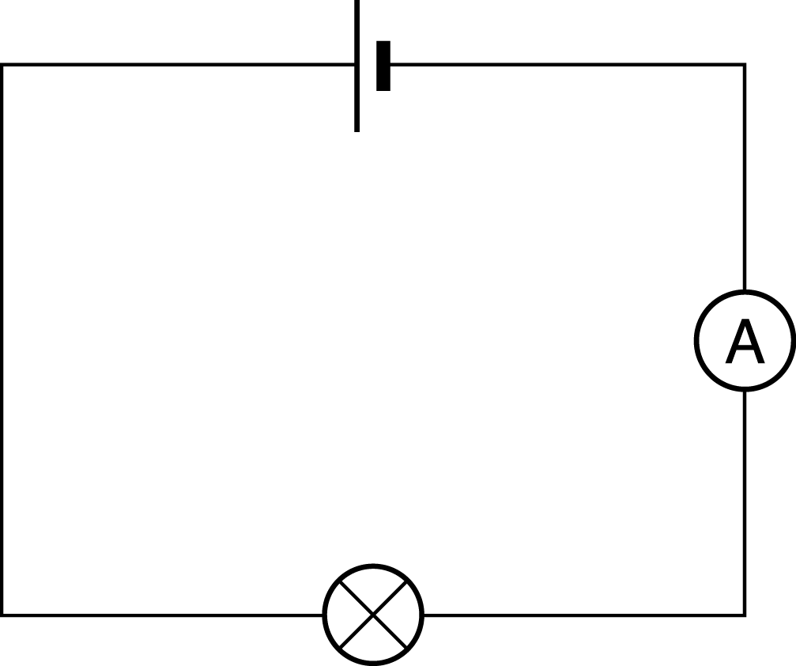
Will the bulb light?

Slide 4
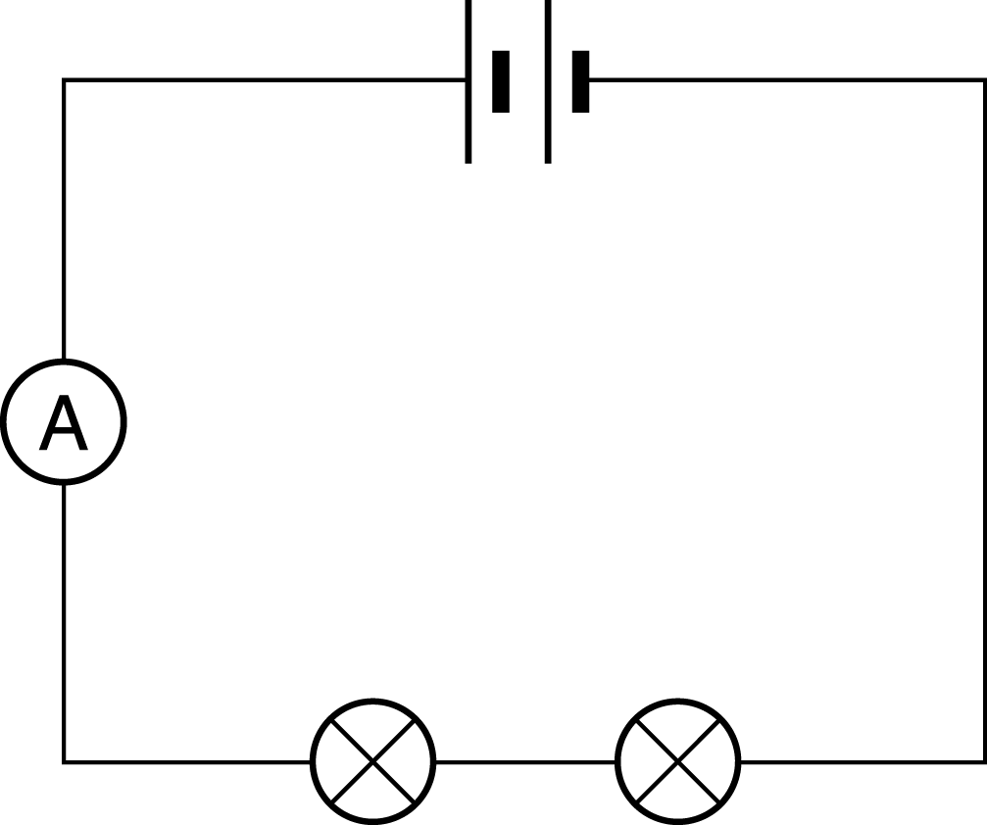
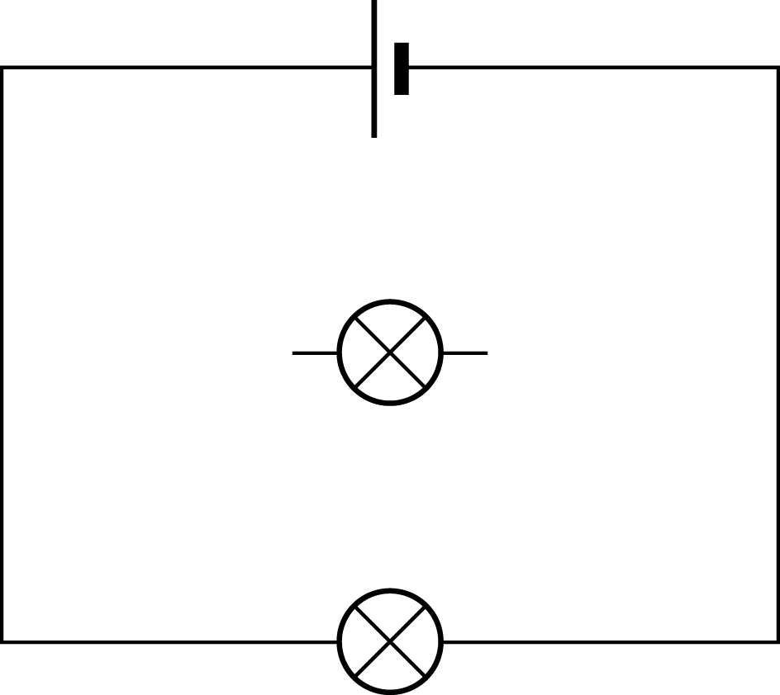
Will the bulb light?

Slide 5
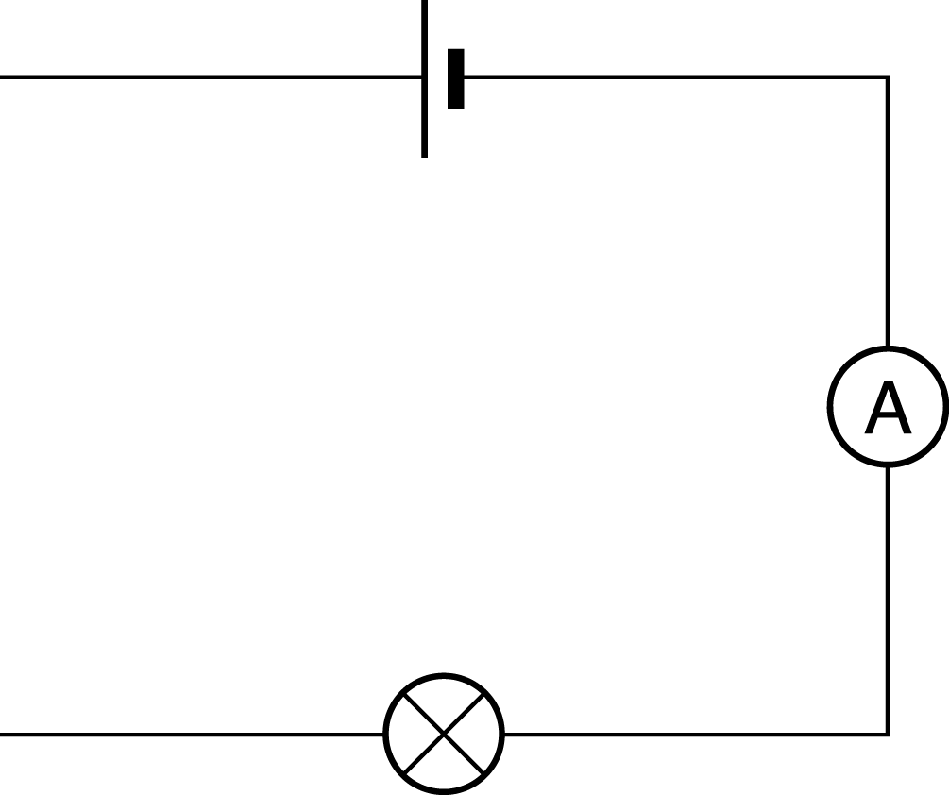
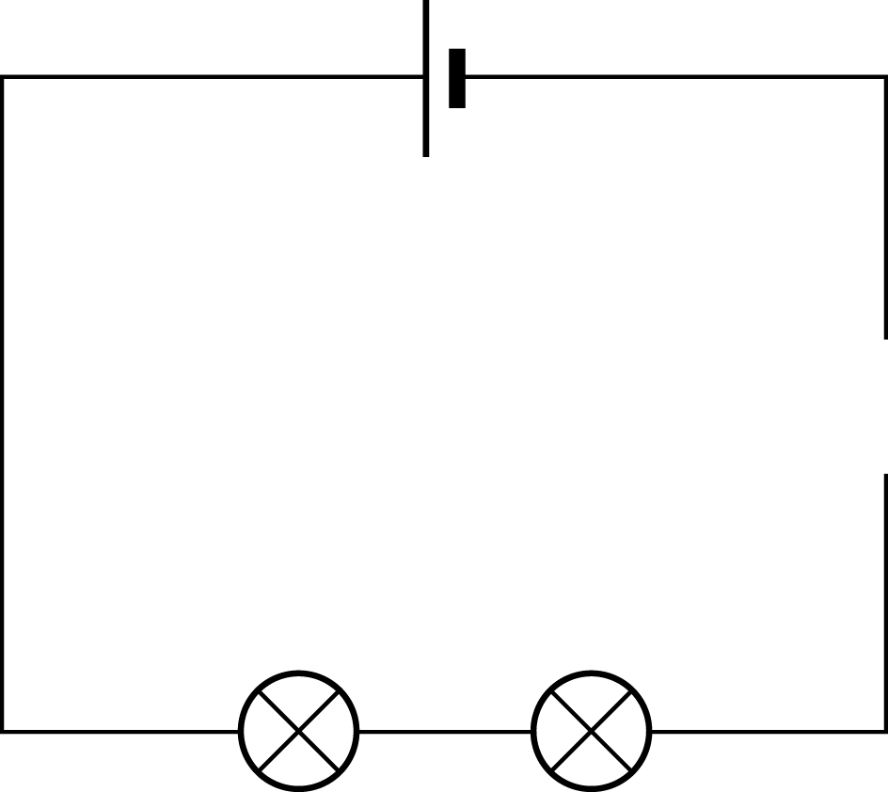
Will the bulb light?

Slide 6

ammeter

Slide 7

bulb or lamp

Slide 8

switch

Slide 9

cell

Slide 10

voltmeter

Slide 11
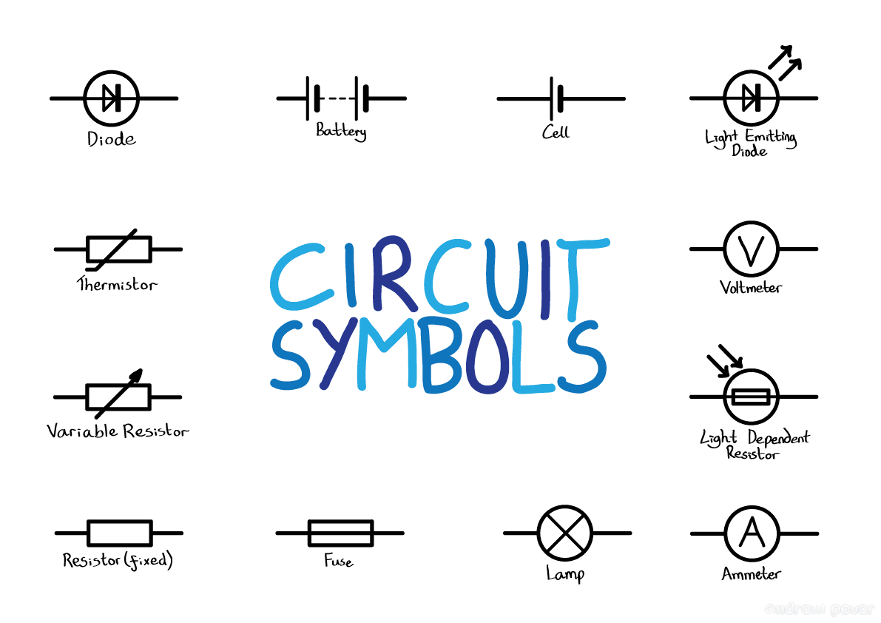
Circuit symbols

Slide 12
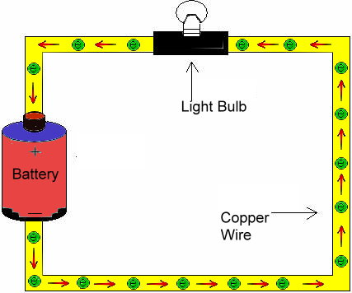
A simple circuit showing electron flow.

Slide 13
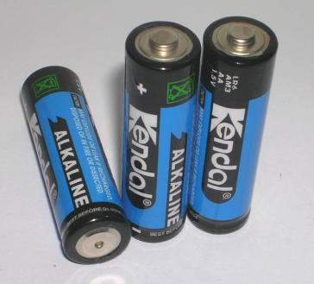
What is the energy change which takes place in a battery?
Chemical to Electrical

Slide 14
Electrical Charge
Electric charge is given the symbol
Q
Electrons are the charge carriers
that flow in an electrical circuit –
from the negative to positive terminals.
2.21 mins https://www.youtube.com/watch?v=oB1v-wh7EGU

Slide 15

Electrical Charge EXTENSION
Electrons are so very, very tiny that we measure large groups of them called coulombs. There are 6.25 x 10¹⁸ electrons in one coulomb.
The charge on one electron is 1.6 x 10⁻¹⁹ coulombs (C)

Slide 16
Electrical Charge
The charge on a electron is
1.6 x 10⁻¹⁹C

Slide 17
Charge, Current & Time
Electric current is given the symbol
I
Current is the amount of charge flowing per second and is given the unit
Amps (A)

Slide 18
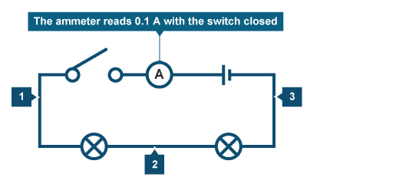
Experiment to measure current in series
ammeter
12v
Set up a series circuit with two 12v bulbs and a powerpack with a switch. Measure the current flowing at points 1, 2 and 3

Slide 20
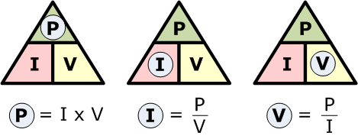
Working out power

Slide 21
Calculate the power
1. A series circuit had a current of 2.0 amps and the voltage of the bulb is 3.0 volts. Calculate the power.
2. A series circuit had a current of 4.5 amps and the voltage of the buzzer is 2.0 volts. Calculate the power.

Slide 22
Yesterday’s results

Slide 23
Experiment to measure voltage in series
ammeter
12v
Add the voltmeter to the following components and record the voltage:
Bulb 1
Bulb 2

Slide 24
Can you find the mistakes in this paragraph about current?
Current is the amount of electricity flowing around a circuit. We measure current using an Amp. Current is measured in Volts. The current is the same anywhere in a circuit, so it does not matter where an ammeter goes in a circuit. Current is used up as it goes around the circuit.

Slide 25
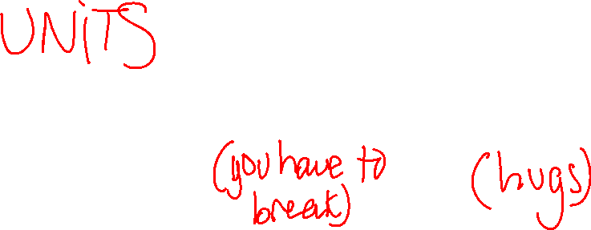
Summary
 | CURRENT | VOLTAGE
Measured in
Measure with
Amps, A
Volts, V
Ammeter
Voltmeter

Slide 26

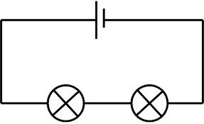

Measuring Voltage in series circuits
Measure the voltage across the supply Vs
Measure the voltage across the first light bulb V₁
Measure the voltage across the second light bulb V₂
Write an equation connecting Vs, V_{1,}and V₂

Slide 27
Summary
 | Series | Parallel
Current | SAME | SPLIT
Voltage | SPLIT | SAME

Slide 28
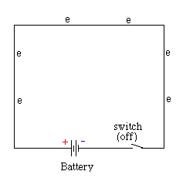
The coulombs start with (for example) 12J of energy each.
They have “electrical potential energy”.
As the coulombs travel round the circuit this energy is changed to other forms.
When the coulombs have travelled back to the battery they have transferred all their energy to other forms.

Slide 29
Where does most of the energy tranformation take place?
In the conducting wires the coulombs lose very little energy as the wires are made of a conductor (copper).
The light-bulb filament is made of resistance wire and this causes the coulombs to lose most of their energy in the bulb.
When the coulombs get back to the battery they have transferred all of their electrical potential energy and have no energy left.

Slide 30
What has “potential difference” got to do with voltage?
It is the same thing!
The potential difference (p.d.), or voltage (unit volts),of a battery or cell is a measure of the electrical energy given to one coulomb of charge passing through the battery.
Voltage = energy per coulomb
V = E/Q

Slide 31
Potential Difference or Voltage (V)
A 9 V battery will give how much energy
to each coulomb of charge passing
through the battery?
9 J
Now try some questions on the worksheets

Slide 32
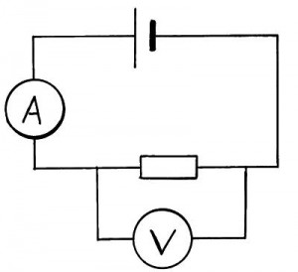

How can we measure voltage?
Voltage (or p.d.) can be measured using a
voltmeter.
An ammeter is connected
in the circuit in series.
but a voltmeter must be connected across (hug)
the component (in parallel).
V

Slide 33
You can’t measure voltage…
in a circuit
through a circuit
through a component
flowing

Slide 34
Tuesday
Insulation experiment
POWER

Slide 35
Let’s watch this video before we do the INSULATION experiment.
https://www.youtube.com/watch?v=cYifAaTFe8A
3.21 mins

Slide 36
Wednesday
Recap voltage current and power.
Calculations
Intro series and parallel

Slide 37
Friday
Recap series and parallel
Investigation and design challenge

Slide 38
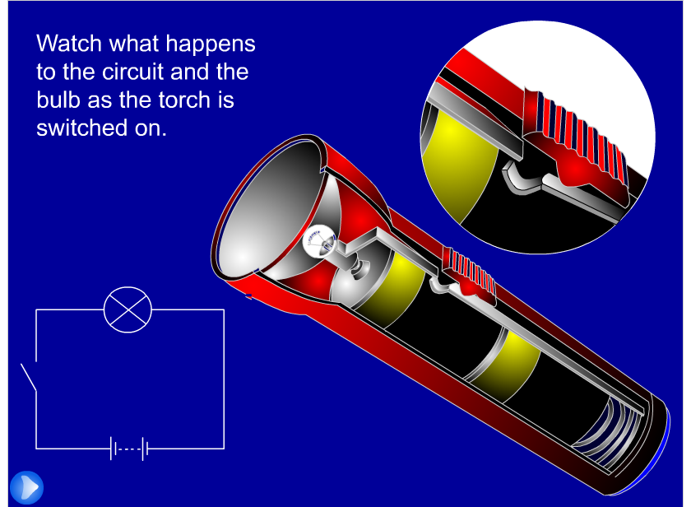
7J Connecting circuits – Switch on

Slide 39
Your Task
Design a circuit that can test for faulty components.
Design circuit
Draw circuit using symbols in our book
Explain how to use it

Slide 40
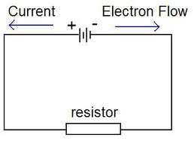
Conventional current
Very unfortunately when electricity was discovered the physicists decided that the charge flowing was positive!!!!!
We still use this conventional current but it really doesn’t make any difference which way the current flows !

Slide 41
Electrical Charge
Electric charge is given the symbol
Q
Electrons are the charge carriers
that flow in an electrical circuit –
from the negative to positive terminals.
2.21 mins https://www.youtube.com/watch?v=oB1v-wh7EGU

Slide 42
Electrical Charge EXTENSION
Electrons are so very, very tiny that we measure large groups of them called coulombs. There are 6.25 x 10¹⁸ electrons in one coulomb.
The charge on one electron is 1.6 x 10⁻¹⁹ coulombs (C)

Slide 43
Electrical Charge
The charge on a electron is
1.6 x 10⁻¹⁹C

Slide 44
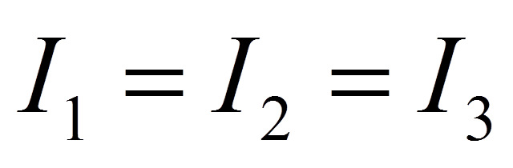
Kichoff’s first law
The current is the same at all points in a series circuit
Charge (electrons) don’t get used up.
Charge is conserved.

Slide 45
Charge, Current & Time
If current is charge flowing per second then
so a current of 1 A is 1 C of charge transferred in 1 s.
Charge transferred in coulombs (C)
Current in Amps (A)
time in seconds (s)
Try the worksheet

Slide 46
Now try some questions
GCSE bitesize questions

Slide 47
Senior physics video potential difference

Slide 48
When a battery is in a circuit…
The electrical energy is carried by the
electrons that move round the circuit.
It is converted into others forms of
energy.

Slide 49
Energy is conserved
The voltage of the supply is the energy given to each Coulomb.
The voltages across each bulb is the energy lost by each coulomb as it travels through.
If we can ignore the conducting wires then by conservation of energy
V_{s} =V₁+V₂

Slide 50

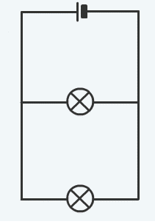
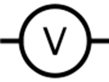

Measuring Voltage in a parallel circuit
Put the power pack on 12v
Connect two bulbs in parallel.
Measure the voltage of the supply V_{s}
Measure the voltages across each bulb V₁ and V₂.
What conclusion can you draw?
Can you explain these results?

Slide 51



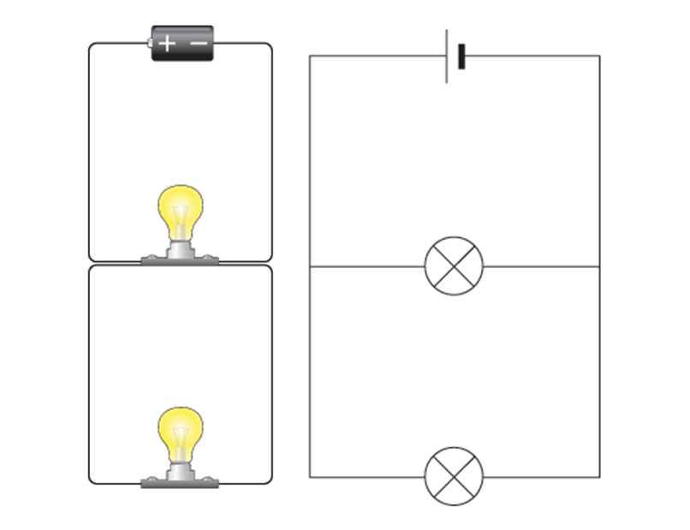


Voltage law in parallel
V_{s} =V₁=V₂
The coulombs can only travel through one branch of the parallel circuit so they must lose most of their energy there.

Slide 52
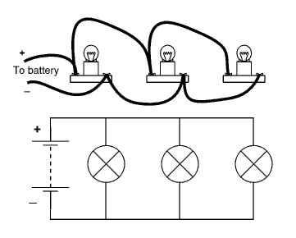
What happens if we add more bulbs in parallel?
Will they all have the same voltage across them?
Try it and see!

Slide 53
Revision GCSE bitesize
Or go to the website furry elephant
User name jackie
Password medlock
Go to the lesson on current and voltage
There are some nice animations and also you can choose games and quizzes.

Slide 54
Disadvantages of Series Circuits
When one component breaks the whole circuit stops working as no current flows.
The voltage is divided between the bulbs. so the more bulbs added the dimmer each one is.
The components can’t be switched on and off separately

Slide 55
Advantages of a Parallel Circuit
When one bulb breaks the rest of the circuit
continues to work.
The voltage in each branch is the same as
the supply voltage. Therefore, bulbs in parallel
will each be as bright as a single bulb.
Each component can be switched on and off separately.

Slide 56
Electrical Resistance
By the end of this lesson you should be able to:
Understand that the current in a series circuit depends on the applied voltage and the number and nature of other components.
Describe the qualitative effect of changing resistance on the current in a circuit
Recall and use the relationship between voltage, current and resistance

Slide 57
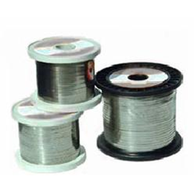
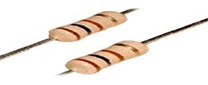
Resistors
The ciruit symbol for a resistor is
Notes:
57
57

Slide 58
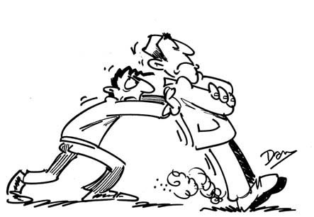
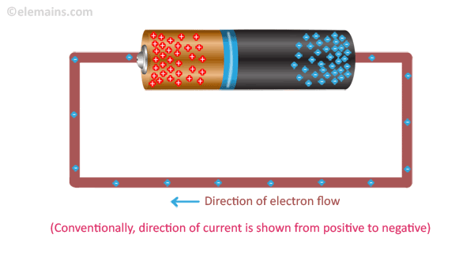
Electron flow and Resistance
As the electrons move along the wire they collide with the metal atoms. These collisions make the atoms vibrate more which makes the metal hotter.
Resistance is a measure of how much a material tries to stop electricity passing through it.
4 mins https://www.youtube.com/watch?v=ue6w5aXhxjU

Slide 59
Resistors Use these words to fill in the gaps below: insulators, copper, current, heat, resistors, conductors, alloys
Conductors such as cables have very little resistance and so very little electrical energy is changed to .
have very, very large resistances and so no________ can flow.
are inbetween.
They allow current to flow but not as well as____________
The bigger the resistance the smaller the __________
(for the same voltage).
Resistance wires are made of a mixture of metals e.g nichrome or constantin
copper
heat
Insulators
current
Resistors
conductors
current
alloys
Notes:
59
59

Slide 60

Definition of Resistance
The resistance of a resistor is defined as the voltage across the resistor divided by the current flowing through it.
Resistance = voltage
current
Volts v
OhmsΩ
Amps A
Ohm’s law
Notes:
60
60

Slide 61

Measure some resistances:
Put the power pack on 10v.
Measure the current and the voltage across a metal resistor.
Voltage = __________
Current = __________
Resistance R =V/I = ___
Find the resistance of a light bulb in the same way.
Find out what happens to the total current flowing when you put both the light bulb and the resistor in series.

Slide 62
What can you say about current and
resistance for a fixed voltage?
decreases
As resistance increases, the current…..
decreases
As resistance decreases, the current …..
increases
Notes:
62
62

Slide 63
Using Ohm’s law:
For a voltage of 12V, calculate the
current for a resistance of
4 Ω
24 Ω
1 k Ω
Notes:
63
63

Slide 64
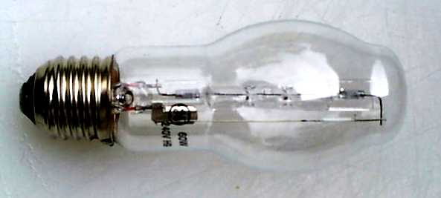
Resistance for a bulb
If you have a filament bulb and it has a current of 20A running through it, with a potential difference of 100V across it, what is the resistance of the bulb?
V = IR
R = V/I
R = 100V/20A
R = 5 Ω

Slide 65

Formula triangles
Formula triangles help you to rearrange formula, the triangle for the Ohm’s Law is shown below:
Whatever quantity you are trying to find cover it up and it will leave you with the calculation required.
…and you are left with the sum…
So if you were trying to find current, I…..
I = V
V
R
÷
÷
…you would cover I up…
I
R
x

Slide 66

Varying Resistance
A variable resistor can be used to vary the current in a circuit
Notes:
66
66

Slide 67
Current for a diode
A diode has a current of 5A running through it, and a resistance of 5Ω. What is the potential difference across the diode?
V = IR
V = 5A x 5Ω
V = 25V

Slide 68
Lesson 2 and 3
Investigating how current varies with voltage for 3 different circuit components
By the end of the lesson you should be able to:
Describe how current varies with voltage in wires, resistors, metal filament lamps and diodes, and how this can be investigated experimentally.

Slide 69
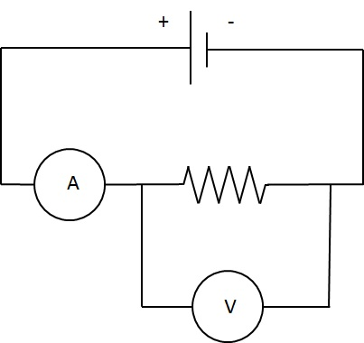
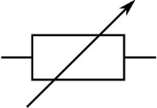
Experiment to investigate I/V curves for a resistor, a filament and a diode.
rheostat
Voltage V | Current I
Fixed resistor
In this circuit the rheostat is being used as a voltage divider

Slide 70
Variable Resistors
What do you expect
to happen to the current and the brightness of the bulb if you increase the value of the resistor in the circuit shown?
cell
A
lamp
Variable resistor
Notes:
70
70

Slide 71
Relationship between current and voltage in a fixed resistor
A straight line through
the origin tells us that current is directly proportional to voltage
The gradient of the line gives us the ratio of I/V.
current / Amps
The ratio V/I is the reciprocal of the gradient. It is equal to the resistance of the resistor.
A metal resistor has a constant resistance.But only if the temperature stays constant
voltage (volts)
Notes:
71
71

Slide 72
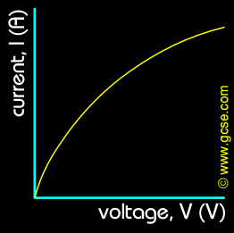
I/V curve for a light bulb
The gradient is decreasing and so the resistance of the filament must be increasing.
The current is increasing as voltage increases but not as much as for a constant resistance.

Slide 73
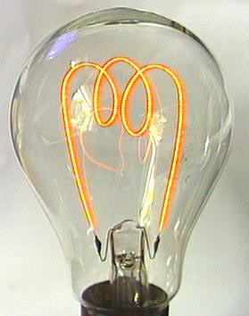
Filament Lamp
Electric current
passes through the
resistance wire which
is made of tungsten.
Electrical energy is
changed into heat
energy and the
wire glows white hot.
Filament lamps
produce both heat and
Light.
Notes:
73
73

Slide 74
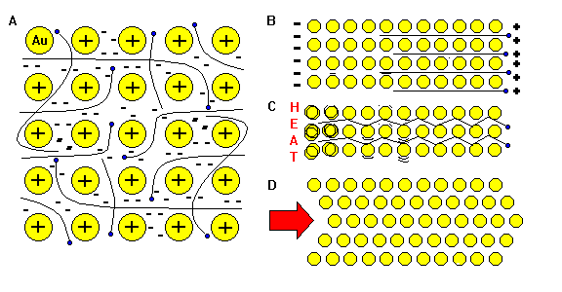
I/V curve for a light bulb
In the fixed resistor, current and voltage are directly proportional. But for a light bulb as the current increases, the electron/ion collisions causes the ions to vibrate more (the filament heats up). This increases electron/ion collisions even more and so the resistance of the filament increases every time the current increases.
Notes:
74
74

Slide 75
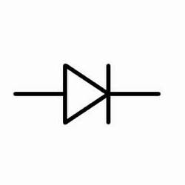
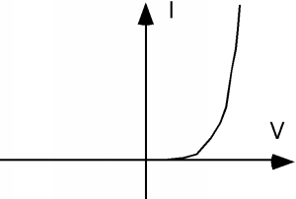
I/V curve for a diode
The arrow shows the direction of conventional current when the diode conducts.
Diodes only let current flow through them in one direction. They can be used to show that current is flowing in a circuit and in which direction.
Diodes are also used to change alternating current to direct current

Slide 76
Resistors in series and parallel
How does the total resistance of a circuit change if we connect:
More than one resistor in series?
More than one resistor in parallel?

Slide 77
Special Resistors
Lesson 4
By the end of the lesson you should be able to:
Describe the qualitative variation of resistance of LDRs with illumination and of thermistors with temperature.
Experiment sheet to investigate the properties of LDRs and thermistors.

Slide 78
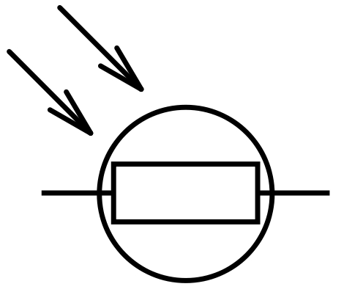
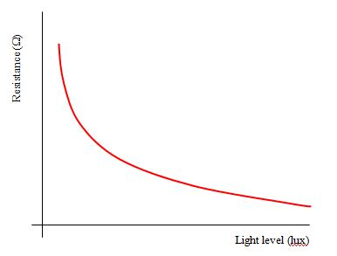

Light Dependent Resistors
The resistance of an LDR decreases as the light intensity increases

Slide 79
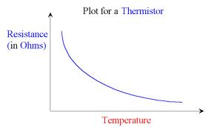
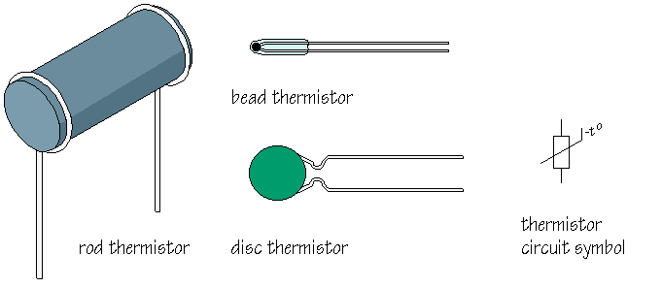

Thermistors
The resistance of a thermistor dcreases as the temperature increases

Slide 80
Circuits Quiz.
What have you learnt?

Slide 81
Voltage/current graphs
I
1
I
2
I
3
I
4
V
V
V
V
2
A. A filament lamp.
B. A diode.
C. Wires of different materials.
D. A metal resistor.
4
3
1

Slide 82
What are the units of resistance?
Amps
Ohms
Volts
Watts
✓

Slide 83
What does the circuit symbol shown represent?
Voltmeter
Variable resistor
Light dependent resistor
Thermistor
✓

Slide 84
If two resistors of 4 Ω and 4 Ω are placed in parallel, what is their total resistance in the circuit?
10 Ω
2 Ω
2.4 Ω
24 Ω
✓

Slide 85
If a resistor has a potential difference of 10V across it and a current of 0.2 A flowing through it.
What is its resistance?
50 Ω
2 Ω
0.5 Ω
15 Ω
✓

Slide 86
What type of circuit is this?
series
A
Name the components
V
V
Notes:
86
86

Slide 87
The supply voltage is 6V. What is voltage V₁? V₂?
10Ω
10Ω
V₁
V₂
Notes:
87
87

Slide 88
LAST LESSON
Go through worksheet answers.

Slide 89
Electrical Charge
Electric charge is given the symbol
Q
Electrons are the charge carriers
that flow in an electrical circuit –
from the negative to positive terminals.
2.21 mins https://www.youtube.com/watch?v=oB1v-wh7EGU

Slide 90
Electrical Charge EXTENSION
Electrons are so very, very tiny that we measure large groups of them called coulombs. There are 6.25 x 10¹⁸ electrons in one coulomb.
The charge on one electron is 1.6 x 10⁻¹⁹ coulombs (C)

Slide 91
Electrical Charge
The charge on a electron is
1.6 x 10⁻¹⁹C

Slide 92
REVIEW

Slide 93
ammeter

Slide 94
bulb or lamp

Slide 95
switch

Slide 96
cell

Slide 97
voltmeter

Slide 98
Resistors
The ciruit symbol for a resistor is
Notes:
98
98

Slide 99
Varying Resistance
A variable resistor can be used to vary the current in a circuit
Notes:
99
99

Slide 100
Calculate the power
1. A series circuit had a current of 2.0 amps and the voltage of the bulb is 3.0 volts. Calculate the power.
2. A series circuit had a current of 4.5 amps and the voltage of the buzzer is 2.0 volts. Calculate the power.

Slide 101
Summary
 | CURRENT | VOLTAGE
Measured in
Measure with
Amps, A
Volts, V
Ammeter
Voltmeter

Slide 102
Summary
 | Series | Parallel
Current | SAME | SPLIT
Voltage | SPLIT | SAME

Slide 103
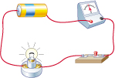
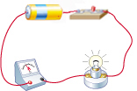
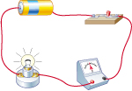
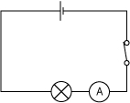
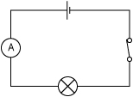
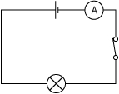
Match each series circuit to the correct circuit diagram.
A
B
C
3
1
2
2
3
1

Slide 104

This is the energy source for the circuit.
Match
When a lamp is switched on it changes electrical energy into two other kinds of energy. Choose some of these words to fill in the gaps.
The cell has a store of
energy.
The wires transfer
energy from the __
to the .
The lamp transfers the energy as
and energy.
switch
You need to close this to complete the circuit!
circuit
cell
This must be complete (no gaps) for electricity to flow round it.
electrical
cell
movement
chemical
electrical
light
chemical
lamp
cell
lamp
heat
sound
light
heat

Slide 105
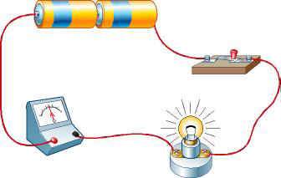
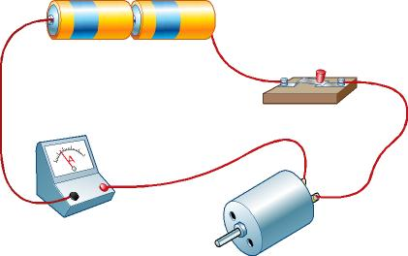
Both these circuits have the same number of batteries.
D
E
Why do the ammeters show different current readings?
There is less current in circuit E which means it's harder for the current to flow in the circuit with the motor.
Which component has the greater resistance?

Slide 106

7J Connecting circuits – Circuits quiz
1. The parts that are connected to make an electrical circuit are called…
a) computers.
b) components.
c) consonants.
2. The three things needed to make a circuit are a power supply, an electrical device and…
a) wires.
b) a plug.
c) batteries.
Notes:
TEACHER’S NOTES
Answers
1b)
2a)

Slide 107

7J Connecting circuits – Circuits quiz
3. The flow of electrical charge around a circuit is called the…
a) raisin.
b) battery.
c) current.
4. The symbol represents which electrical component?
a) A switch.
b) A bulb.
c) An ammeter.
Notes:
TEACHER’S NOTES
Answers
3c)
4b)

Slide 108



7J Connecting circuits – Circuits quiz
5. What is the symbol for a cell?
a)
b)
c)
6. When a switch is closed, an electrical circuit is said to be…
a) complete.
b) broken.
c) positive.
Notes:
TEACHER’S NOTES
Answers
5b)
6a)

Slide 109
7J Connecting circuits – Circuits quiz
7. Batteries should be connected so that their poles are arranged…
a) positive to positive.
b) negative to negative.
c) positive to negative.
8. When a circuit is broken, what happens to the current?
a) the current continues to flow.
b) the current changes direction.
c) the current no longer flows.
Notes:
TEACHER’S NOTES
Answers
7c)
8c)

Slide 110
Disadvantages of Series Circuits
When one component breaks the whole circuit stops working as no current flows.
The voltage is divided between the bulbs. so the more bulbs added the dimmer each one is.
The components can’t be switched on and off separately

Slide 111
Advantages of a Parallel Circuit
When one bulb breaks the rest of the circuit
continues to work.
The voltage in each branch is the same as
the supply voltage. Therefore, bulbs in parallel
will each be as bright as a single bulb.
Each component can be switched on and off separately.

Slide 112
Resistors in series
Total resistance = R₁ + R₂
4Ω
2Ω
What is the total resistance for the circuit shown?
Total resistance = R₁ + R₂
Total resistance = 4 Ω + 2 Ω
Total resistance = 6 Ω

Slide 113
Resistors in series
What is the total resistance for the circuit shown?
6Ω
34Ω
Total resistance = R₁ + R₂
Total resistance = 6 Ω + 34 Ω
Total resistance = 40 Ω

Slide 114
Resistors in parallel
If we connect resistors in parallel the total resistance of the circuit dcreases because there are more branches through which the current can flow.
4Ω
2Ω
Total resistance = R₁xR₂ R₁+ R₂
Total resistance = 4 x 2
4 + 2
= 1.33Ω
The total resistance is always smaller than the smallest resistor.

Slide 115
Resistors in parallel
What is the total resistance for the circuit shown?
8Ω
6Ω
Total resistance = 8 x 6
8 + 6
= 3.4Ω

Slide 116

Using conductive putty

Slide 117


Using copper tape

Slide 118

Using conductive paint

