Slide 1
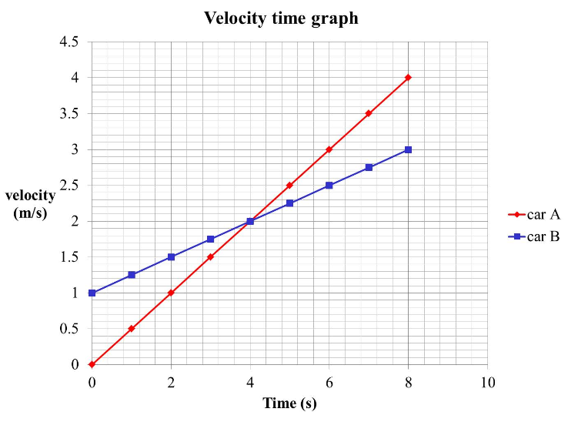
a) Which car has the greatest acceleration?
b) Calculate the acceleration of each car over the 8 seconds shown on the graph?
c) find the average velocity of each car during the 8 seconds shown?
a)The velocity time graph for car A is has a greater gradient so A has the largest acceleration
b) the velocity of A increases from 0 to 4 in 8 seconds, so the acceleration is a = ∆v/∆t = 4/8 = 0.5 m/s²
the velocity of B increases from 1 to 3 in 8 seconds, so the acceleration is a = ∆v/∆t = 2/8 = 0.25 m/s²
c) the average velocity of A is (0+4)/2= 2m/s the average velocity of B is (1+3)/2 = 2m/s, so they have the same average velocity.

Slide 2
Say what the car was doing during each part of the journey
Calculate the acceleration for each part of the journey
What does a negative velocity mean
What does a negative acceleration mean

Slide 3
Show the displacement of the model electric train during the first 5 seconds is 7m.
describe the motion during the first five seconds
Calculate the acceleration that takes place between t = 0 and t = 1 second?
what is the acceleration between time 1 to 3 seconds?
what is the velocity between time 1 to 3 seconds?
Calculate the acceleration that takes place between t = 3 and t = 5 second?, what does the negative sign mean?
Does the model electric train get back to the station after 11.5 seconds?

Slide 4
Say what the truck was doing during each part of the journey
Calculate the velocity during each section
Sketch a velocity time graph
What does a negative displacement mean
What does a negative velocity mean
Improve the description you made at the start

